Slide 1
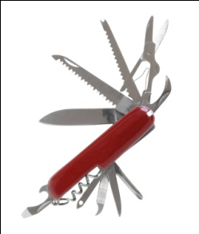
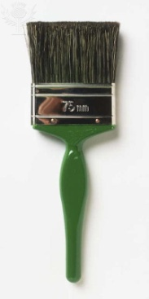
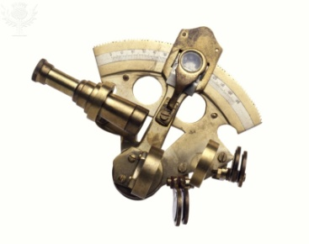
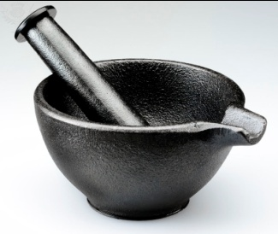
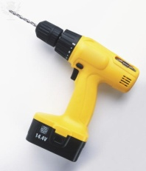
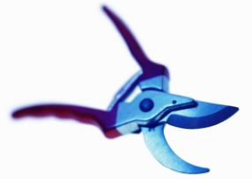
Ten Tools a collection of organizational & individual methods to aid effectiveness

Slide 2
How do I…
Know what to do?
Gap analysis
Sensemaking
Ideal-setting
Get things done?
Collaboration
Performance
Nurture and enhance relationships?
Collaboration
Communication
Develop myself?
Personal mastery
Gap Analysis
Sensemaking
Move people and their behavior from point A to point B?
Gap analysis
Influence
Performance
Lead teams to produce desired results?
Collaboration
Performance
Facilitation
Solve problems?
Sense making
Evaluation
Performance
Notes:
The 10 tools are a set of ways of looking at the world in situations so as to be more effective. All of us at work are confronted with questions – if we bothered to be aware and we care about being successful – that need answers. And those answers must be more than mere prescriptions; those answers must contain within them the means by which we can make things different. The 10 tools are way for us to know more clearly what to do, to get things done more efficiently and more effectively with less breakdowns, to improve and strengthen our relationships that are critical to the success of any individual in any enterprise, to allow us to do capital C. change management, to lead teams to produce their objectives, and to solve problems.

Slide 3
Ten Tools
Snyder's Six Steps
Atom of Work
Gap Analysis
Difficult Conversations
Mental Maps
Advocacy versus Inquiry
Team Effectiveness
Problem-solving techniques
Seven Influence Strategies
Feed Forward & Johari Window
Events of Instruction

Slide 4
Session | Date | Competencies
Atom of Work | 2/24/15 | Results orientation Relationship Mastery / People Skills
Gap Analysis | 3/18/15 | Results orientation Market and Customer Orientation/ Insight
Difficult Conversations | 4/7/15 | Results orientation Relationship Mastery / People Skills
Mental Maps | 5/28/15 | Results orientation Relationship Mastery / People Skills Market and Customer Orientation/ Insight Learning Agility
Advocacy versus Inquiry | 6/23/15 | Learning Agility Relationship Mastery / People Skills
Problem Solving | 7/29/15 | Results orientation Market and Customer Orientation/ Insight Learning Agility
Team Effectiveness | 8/25/15 | Results orientation Relationship Mastery / People Skills
Seven Influence Strategies | 9/29/15 | Results orientation Relationship Mastery / People Skills
FeedForward and Johari Window | 10/27/15 | Relationship Mastery / People Skills
Events of Instruction | 11/30/15 | Learning Agility
(Bonus) Seven hallmarks of survivors and thrivers | 12/14/15 | Life skills!!!
Extra day hold
Notes:
Handout

Slide 5
What Might You Gain From This Session?
Given a performance situation with a Question of how you will be able to surmount a challenge you will:
Identify the factors that various researchers have found to be consistent with greater chances for survival and even for optimization

Slide 6
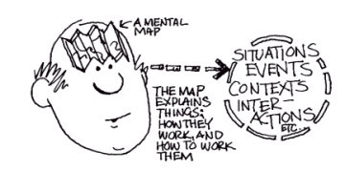
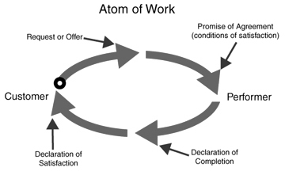
How Other Tools Fit With Mental Maps
Snyder's Six Steps
How do I impart what I know?
How am I doing in all of this work? Do I have
a ‘blind spot’? FeedForward & Johari Window
What You Should Request
Agreeing on What 'Done' Looks like
Notes:
Handout

Slide 7
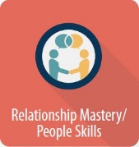
ETS Success Six Connections
Relationship Mastery/People Skills
As we seek to build and sustain trusting and effective relationships, we will find circumstances where it is necessary for us to impart knowledge to others
Results Orientation
Delivering on promises and commitments: Select the right actions to take

Slide 8
Another view of how ten tools mesh
Atom of Work
Difficult Conversations
Gap Analysis
Feed-forward
Group effectiveness
Group
Events of Instruction
Facilitation
Problem-solving Techniques
Advocacy versus Inquiry
Mental Maps
Personal Mastery
Group Effectiveness
Organizational Sagacity
Snyder's Six Steps
Personal mastery
Gap Analysis
7 Influence Strategies

Slide 9
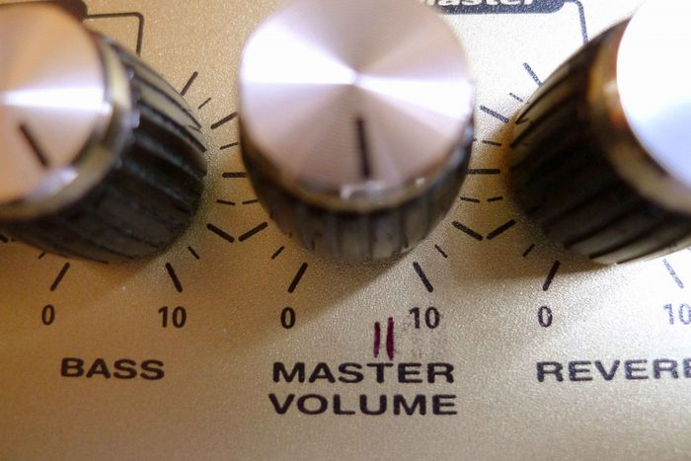
Session 11 Snyder’s Six Steps
Events of Instruction

Slide 10
Hope Scale *
Directions: read each item carefully. Using the scale below, please select the number that best describes you and put that number in the blank provided.
1 = Definitely False 2 = Mostly False 3 = Mostly True 4 = Definitely True
___ I energetically pursue my goals.
___ I can think of many ways to get out of a jam.
___ My past experiences have prepared me well for my future.
___ There are lots of ways around any problem.
___ I've been pretty successful in life.
___ I can think of many ways to get the things in life that are most important to me.
___ I meet the goals that I set for myself.
___ Even when others get discouraged, I know I can find a way to solve the problem.
* = see notes for authors
Notes:
developed by CR Snyder, Cherie Harris, John R Anderson, Sharon A Holleran, Laurie A. Irving, Sandra T Sigmon, Laurent Youshonobu, June Gibb, Cherylle Langelle, and Pat Hearney, Journal Of Personality And Social Psychology, 1991, volume 60 (four), 570 — 585

Slide 11
All Quotes in This Presentation Are from the Work of CR Snyder

Slide 12
Are There Any Differences Between Who Succeeds And Who Doesn’t?
Steadily Thriving
Barely Surviving

Slide 13
Success Is More Than Just Hope But…
Social Capital
Cognitive Skills & Knowledge
Luck
$$$
Interpersonal Skills
Notes:
Human capital includes:
A broad set of cognitive skills and knowledge
Interpersonal skills (collaboration, teamwork, …)
Character traits (motivation, persistence, reliability, self-discipline, …)
Social capital includes:
Family and social networks
Norms and values that guide behavior

Slide 14
It's a good place to start
Notes:
It is important to emphasize that hopeful thinking
necessitates both the perceived capacity to
envision workable routes and goal-directed energy.
Thus, hope is “a positive motivational
state that is based on an interactively derived
sense of successful (1) agency (goal-directed energy)
and (2) pathways (planning to meet
goals)” (Snyder, Irving, & Anderson, 1991,
p. 287). In the progression of hopeful thinking
in the goal-pursuit sequence, we hypothesize
that pathways thinking increases agency thinking,
which, in turn, yields further pathways
thinking, and so on. Overall, therefore, pathway
and agency thoughts are iterative as well as additive
over the course of a given sequence of
goal-directed cognitions (see Snyder, Harris, et
al., 1991).

Slide 15
Snyder's Six Steps or Attributes
Turn to friends for advice on how to achieve their goals.
Tell themselves they can succeed at what they need to do.
Even in a tight spot, they tell themselves things will get better as time goes on.
They are flexible enough to find different ways to get to their goals.
If hope for one goal fades, they aim for another.
"Those low in hope tend to become fixated on one goal, and persist even when they find themselves blocked," Dr. Snyder said. "They just stay at it and get frustrated."
They show an ability to break a formidable task into specific, achievable chunks.
"People low in hope see only the large goal, and not the small steps to it along the way," Dr. Snyder said https://nyti.ms/2NhZNJb
Notes:
https://nyti.ms/2NhZNJb

Slide 16
Hope Is a Sum…
Willpower
'Waypower'
Goals
of the mental Willpower and Waypower that you have for your Goals

Slide 17
Goals
Willpower
'Waypower'
Goals
"Something we want to obtain — such as an object — or attain — like an accomplishment. … Mental targets for our thoughts"

Slide 18
Examples of Goals?

Slide 19
Begin With A Specific Goal In Mind
even though it may shift — or you may alter it — along the way

Slide 20
Willpower
Willpower
'Waypower'
Goals
"Willpower is the driving force in our thinking.… A reservoir of determination and commitment that we can call on to help move us in the direction of the goal which we are attending at any given moment. It is made up of thoughts such as I can, I'll try, I'm ready to do this, and I've got what it takes."

Slide 21
Where Does Willpower Come from?

Slide 22
Does Willpower Emerge from Overcoming past Difficulties?

Slide 23
Waypower
Willpower
'Waypower'
Goals
"Waypower reflects the mental plans or roadmaps that guide hopeful farm.… A mental capacity we can call on to find one or more effective ways to reach our goals."

Slide 24
What do you think Waypower is?

Slide 25
Success is more likely where there’s a will and the WAYS
Willpower
'Waypower'
Goals

Slide 26
Will and Ways — Motivation & Pathways — Reinforce Each Other As We Enact Them
Goals
Stronger Will
Ways Imagined
Even Greater Strength of Will
More Ways Imagined
And on and on…

Slide 27
HOPE is a powerful predictor of advantage in both achievement and coping

Slide 28
Snyder's Six Steps or Attributes
Turn to friends for advice on how to achieve their goals.
Tell themselves they can succeed at what they need to do.
Even in a tight spot, they tell themselves things will get better as time goes on.
They are flexible enough to find different ways to get to their goals.
If hope for one goal fades, they aim for another.
"Those low in hope tend to become fixated on one goal, and persist even when they find themselves blocked," Dr. Snyder said. "They just stay at it and get frustrated."
They show an ability to break a formidable task into specific, achievable chunks.
"People low in hope see only the large goal, and not the small steps to it along the way," Dr. Snyder said

Slide 29
Turn to friends for advice on how to achieve their goals
Do you have a social support network upon which you can call in good and bad times?
Is it reciprocal — do you both give and take support?
When you are giving support, do you concentrate on being present for your friends?
When you seek support, are you looking for a source of additional 'Waypower' as well as a reinforcement of your willpower? Or are you seeking a 'parking space' for your BMW?

Slide 30
Tell themselves they can succeed at what they need to do

Slide 31
Even in a tight spot, they tell themselves things will get better as time goes on

Slide 32
They are flexible enough to find different ways to get to their goals

Slide 33
If hope for one goal fades, they aim for another
Therefore, though they should fail immediately, they had better aim at something high.
Notes:
In the long run men hit only what they aim at. Therefore, though they should fail immediately, they had better aim at something high.

Slide 34
They show an ability to break a formidable task into specific, achievable chunks
"People low in hope see only the large goal, and not the small steps to it along the way“
BUT…
Some goals involve changing systems and you may need to shift between looking at the overall problem and experimenting with solving one particular 'chunk'

Slide 35
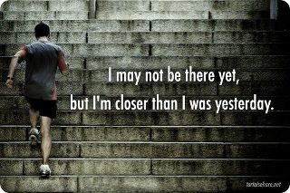
they show an ability to break a formidable task into specific, achievable chunks

Slide 36
So How Did You Score?
___ I energetically pursue my goals.
___ I can think of many ways to get out of a jam.
___ My past experiences have prepared me well for my future.
___ There are lots of ways around any problem.
___ I've been pretty successful in life.
___ I can think of many ways to get the things in life that are most important to me.
___ I meet the goals that I set for myself.
___ Even when others get discouraged, I know I can find a way to solve the problem.
Scores around 24 approximate an average amount of hope. Average in this context actually suggests a strong base of hope.
A score of more than 24 indicates that you usually think in ways that are very hopeful.
A score of less than 24 suggests that you probably do not typically approach things with a hopeful mindset.
Here's the good news: anyone — anyone — can increase their score. Following the six steps is a way of promoting a greater # of hopeful interactions.
Notes:
developed by CR Snyder, Cherie Harris, John R Anderson, Sharon A Holleran, Laurie A. Irving, Sandra T Sigmon, Laurent Youshonobu, June Gibb, Cherylle Langelle, and Pat Hearney, Journal Of Personality And Social Psychology, 1991, volume 60 (four), 570 — 585

Slide 37
How Might You Use What We Have Discussed Today?
Willpower
'Waypower'
Goals

Slide 39
Ten Tools
Snyder's Six Steps
Atom of Work
Gap Analysis
Difficult Conversations
Mental Maps
Advocacy versus Inquiry
Team Effectiveness
Problem-solving techniques
Seven Influence Strategies
Feed Forward & Johari Window
Events of Instruction

