Slide 1
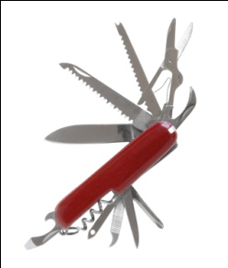
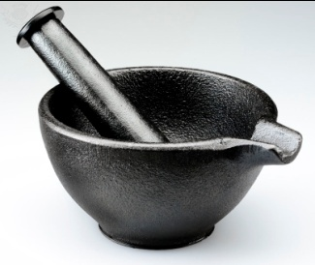
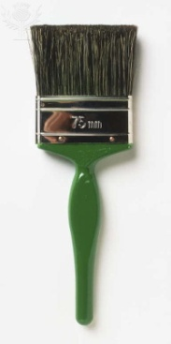
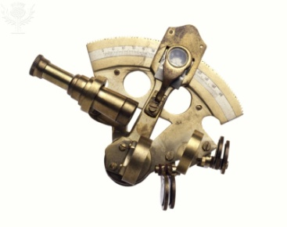
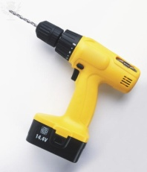
Ten Tools
A collection of organizational and individual methods to aid effectiveness

Slide 2
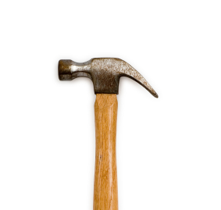
How do I add value?
How do I now what to do?
How do I know where to spend my time?
How do I know how to get things done?

Slide 3
Session 7
Ground Rules for Teams & Facilitation: Process or Product

Slide 4
Placeholder for video while people enter and after we start
http://www.youtube.com/watch?v=I2HqW-AAb20 while they enter run on loop
Another http://www.youtube.com/watch?feature=fvwp&v=mctUNUQSJCo&NR=1

Slide 5
Ten Tools
Atom of Work
Gap Analysis
Difficult Conversations
Mental Maps
Advocacy versus Inquiry
Problem-solving Techniques
Team Effectiveness:Ground Rules for Teams & Facilitation -- Process or Product
Seven Influence Strategies
Feed Forward & Johari Window
Events of Instruction
Notes:
Gap analysis identifies the factors that require intervention in order for your ‘as is’ state to approach the desired ‘to be’ state. The primary source for this session is the books of Jim and Dana Gaines Robinson

Slide 6
How do I…
Know what to do?
Gap analysis
Sensemaking
Ideal-setting
Get things done?
Collaboration
Performance
Nurture and enhance relationships?
Collaboration
Communication
Develop myself?
Personal mastery
Gap Analysis
Sensemaking
Move people and their behavior from point A to point B?
Gap analysis
Influence
Performance
Lead teams to produce desired results?
Collaboration
Performance
Facilitation
Solve problems?
Sense making
Evaluation
Performance
Notes:
The 10 tools are a set of ways of looking at the world in situations so as to be more effective. All of us at work are confronted with questions – if we bothered to be aware and we care about being successful – that need answers. And those answers must be more than mere prescriptions; those answers must contain within them the means by which we can make things different. The 10 tools are way for us to know more clearly what to do, to get things done more efficiently and more effectively with less breakdowns, to improve and strengthen our relationships that are critical to the success of any individual in any enterprise, to allow us to do capital C. change management, to lead teams to produce their objectives, and to solve problems.

Slide 7
With whom will I use these 10 tools?
Family & Friends
Customer
Manager
Vendor
Peer
Report
External Peers

Slide 8
Session | Date | Competencies
Atom of Work | 2/24/15 | Results orientation Relationship Mastery / People Skills
Gap Analysis | 3/18/15 | Results orientation Market and Customer Orientation/ Insight
Difficult Conversations | 4/7/15 | Results orientation Relationship Mastery / People Skills
Mental Maps | 5/28/15 | Results orientation Relationship Mastery / People Skills Market and Customer Orientation/ Insight Learning Agility
Advocacy versus Inquiry | 6/23/15 | Learning Agility Relationship Mastery / People Skills
Problem Solving | 7/29/15 | Results orientation Market and Customer Orientation/ Insight Learning Agility
Team Effectiveness | 8/25/15 | Results orientation Relationship Mastery / People Skills
Seven Influence Strategies | 9/29/15 | Results orientation Relationship Mastery / People Skills
FeedFoward and Johari Window | 10/27/15 | Relationship Mastery / People Skills
Events of Instruction | 11/30/14 | Learning Agility
(Bonus) Six steps | 12/10/14
Extra day hold
Notes:
Handout

Slide 9
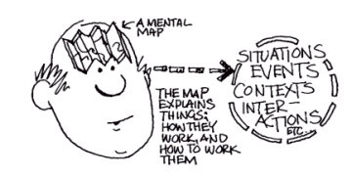
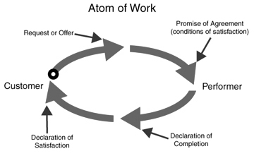
How Other Tools Fit With Team Effectiveness
What You Should Request
Agreeing on What 'Done' Looks like
Notes:
Handout

Slide 10
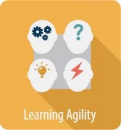
ETS Success Six Connections
Results Orientation
Delivering on promises and commitments: Select the right actions to take
Functional and Technical Acumen
Can you perform your job? Making the highest quality decisions that allow you to do so
Most of us have to work in teams most of the time
Learning Agility
Learn from your setting of criteria for next problem

Slide 11
Summary: Conditions for Team Effectiveness
Real Team
THE
ESSENTIALS
Right
People
Compelling
Direction
TEAM LEADERSHIP
Sound
Structure
Supportive
Context
THE
ENABLERS
Team Coaching

Slide 12
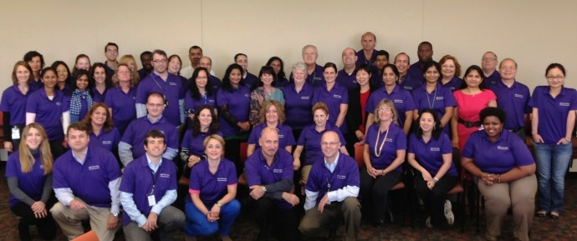
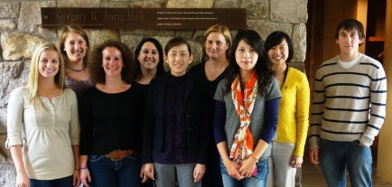
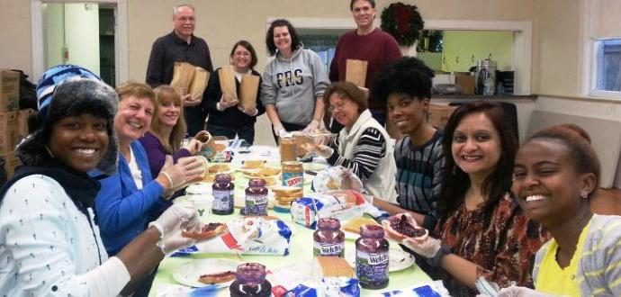
How Is This a Tool?
These points and others that we will share serve as a checklist for the qualities that make a team more likely to be effective
Use them first for diagnosis and then to determine remedies

Slide 13
What Might You Gain From This Session?
Given a performance situation, you will
Choose the right organizational approach: team, work unit, co-located group
Apprehend the “Ten ‘Facts’ About Teams That Aren’t” so as to avoid romanticizing the notion of a team
Use the checklist to diagnose elements of team effectiveness that may be missing or deficient
Understand The Six Conditions of Effectiveness for team success
Facilitate a team more effectively by drawing upon research based guidelines

Slide 14
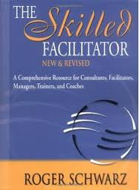
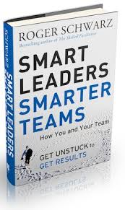
The Advanced Version
Not Today

Slide 15
Five Questions We’ll Try To Answer
What do we mean by ‘team’?
What structure do you need; team, work unit, co-located individuals?
How do you form the team with the best chance for success?
How do you lead such a team?
What are the guidelines to the effective facilitation of a team for process and product?

Slide 16
Team Effectiveness Decision Tree
Is it a team?
Group?
Co-located individuals?
Is it successful?
Produces what the customers want?
Right conditions?
Right People
Able to do it again and again; can take their methods and profitably apply them to other tasks?
Does so in a way that makes the members of the team feel good?
Status mob?
Enabling Structure
Compelling Direction
Supportive Organizational Context

Slide 17
What do we mean when we say ‘team?
Member
Member
Member
Member
Member
How does it differ from a work group, an organizational unit?
Boss
Sidekick
Worker
Worker
Worker
Intake
John
Beth
Triage
Joan
Ron
Tx
Cheryl
Steph
Notes:
Hackman Uses this schema; you will see some other similar formats. What do you think that we mean when we say team? Take a moment and discuss it at your table.

Slide 18
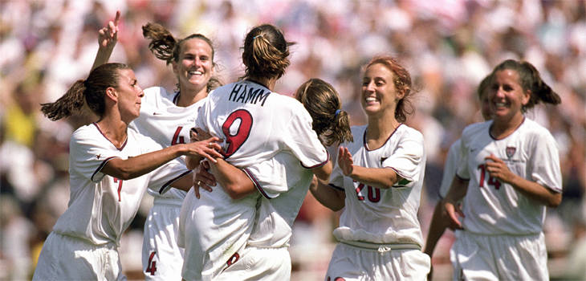
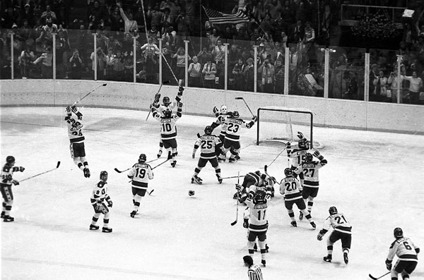
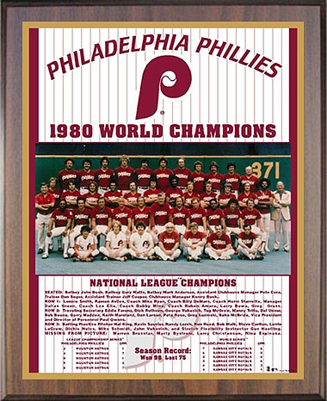
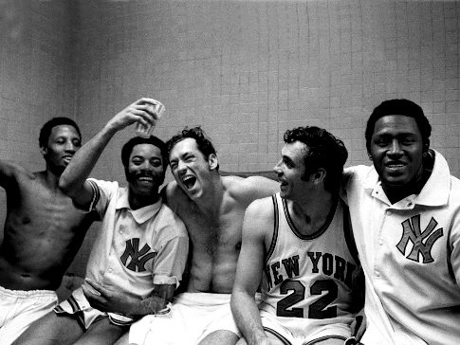
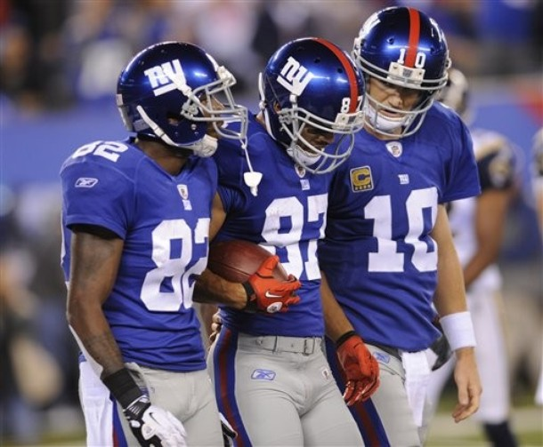
“A single twig breaks but a bundle of twigs is strong” – Tecumseh
We like teams

Slide 19
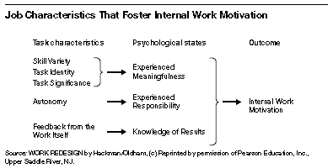
Why People Like Teams
Autonomy, Responsibility, Variety, Significance, Accomplishment

Slide 20
Loaded Language: team, unit, group, individual
“Everybody would agree that a string quartet is a team. Its work simply cannot be accomplished without all four members present and playing. Everybody also would agree that a collection of people on a street corner waiting for a traffic light to change is not.
Beyond such extremes, however, the terms group and team are akin to projective tests. People read into them what they wish, and conversations about teams can be frustrating because people have different things in mind when they talk about them.”
Hackman

Slide 21
Is it a group of co-located individuals or a set of people with a task that requires them to work together to produce something?
“A great deal of organizational work is performed these days by sets of people who are called “teams” but who really are co-acting groups.
Managers in organizations where this is done may harbor the hope that they can harvest the widely touted benefits of teamwork while continuing to directly manage the behavior of individual members.
That hope is misplaced: If you want the benefits of teamwork, you have to give the team the work.
So there is a choice here: Either design the work for a team or design it for individuals”
Hackman
Notes:
Hackman

Slide 22
How do you Choose the right form?
Individual
Team
Workgroup
Notes:
Individual Some kinds of work can and should be handled by a single person. That individual has all the expertise, knowledge, and skills needed to do the job and is solely accountable for getting the job done. If the workload increases so that one person can no longer handle it, the company can create additional positions. Workgroup This work unit consists of a group of people who may work together and may all do essentially the same kind of work but who are not dependent on each other for information and skills needed to accomplish the job. For instance, the regional sales managers of a large national company would constitute a workgroup, even though they aren’t located in the same office. In a human resources department of a large organization, all staff members with responsibilities for administering benefits could be considered a workgroup. They all perform similar or related tasks, but the amount of work is too large for one person. Collaborative Workgroup This is a common work unit category. Individuals in such a group need information from one another in order to achieve results. The work might be handed off from one individual to another, as in a manufacturing system. Each individual completes one step in a complex process that leads to a finished product. In collaborative workgroups, one person’s errors in execution affect the ability of others in the group to do their work.
Kossler, Michael E.; Kanaga, Kim; Center for Creative Leadership. Do You Really Need a Team?.Greensboro, NC, USA: Center for Creative Leadership, 2001. p 12.http://site.ebrary.com/lib/ets/Doc?id=10185409&ppg=13Copyright © 2001. Center for Creative Leadership. All rights reserved.

Slide 23
“A team is a small number of people with complementary skills who are committed to
A common purpose
Set of performance goals
A common approach
For which they hold themselves mutually accountable”
Notes:
Katzenbach and Smith

Slide 24
some situations call for trust in command and control, not teams
As each of the huge boats moves through the (Panama Canal) locks, the clearances are tight. So, a special pilot boards the ship, taking over control from the captain. As they move into a lock, there are electric rail tugs on either side of the canal with steel cables to keep the boat in the middle of the canal. Some have only 6” clearance. The drivers of these tugs receive precise instructions to move forward or tighten the cable from the pilot.
They recently upgraded the tugs and added two-way radios between the tugs (4 to 8 per boat) and the pilot to increase communication. But, it actually led to more scrapes of the boats against the walls and a much slower transit time. It turned out that the tug boat drivers were second guessing the pilot and arguing about the “commands
While we all love collaboration, some situations call for trust in command and control.
Elliott Masie
Notes:
A Canal Tug Boat Lesson: I visited the Panama Canal this week for the first time in 20 years. One big learning lesson happened while taking a 1/2 day transit of this amazing engineering site linking the Pacific to the Atlantic.
As each of the huge boats moves through the locks, the clearances are tight. So, a special pilot boards the ship, taking over control from the captain. As they move into a lock, there are electric rail tugs on either side of the canal with steel cables to keep the boat in the middle of the canal. Some have only 6” clearance. The drivers of these tugs receive precise instructions to move forward or tighten the cable from the pilot.
They recently upgraded the tugs and added two-way radios between the tugs (4 to 8 per boat) and the pilot to increase communication. But, it actually led to more scrapes of the boats against the walls and a much slower transit time. It turned out that the tug boat drivers were second guessing the pilot and arguing about the “commands”. After much consideration, the two-way radios were replaced by one way radios and they returned to an old fashioned bell system. After each command is radioed from the ship to the tug drivers, they confirm that they have received and are executing the command by ringing a bell on the tug.
While we all love collaboration, some situations call for trust in command and control.
From Elliott Masie

Slide 25
“having a team is often worse than having no team at all”
Huh?
“Problems with coordination and motivation typically chip away at the benefits of collaboration” How do you decide if you need a team?
Notes:
Hackman in HBR May 2009

Slide 26
Team Effectiveness Decision Tree
Is it a team?
Group?
Co-located individuals?
Is it successful?
Produces what the customers want?
Right conditions?
Right People
Able to do it again and again; can take their methods and profitably apply them to other tasks?
Does so in a way that makes the members of the team feel good?
Status mob?
Enabling Structure
Compelling Direction
Supportive Organizational Context

Slide 27
features test for teams
Does the situation present…
A team task?
Clear boundaries?
Clearly specified authority to manage their own work processes?
Potential for membership stability over some reasonable period of time
If not, then maybe you don’t need a team
Notes:
Katzenbach and Smith

Slide 28
Do You Need A Team?
Is the task complex?
Simple straightforward tasks don’t require a team
Does it involve controversial org’l change?
The demands oblige us to have a BIG stake
Is it to stimulate innovation?
Do you need different opinions rubbing against each other to point of friction?
A team is effective for designing the new, not then running it
Will having a small group collectively responsible for this significant work make the difference?
Teamwork and team are not the same
The former is a spirit; the latter is a specific structure
Notes:
Do You Really Need a Team? Kossler, Michael E. Kanaga, Kim Center for Creative Leadership
Well-functioning collaborative workgroups may look like teams, but they differ in that each individual is accountable for his
Kossler, Michael E.; Kanaga, Kim; Center for Creative Leadership. Do You Really Need a Team?.Greensboro, NC, USA: Center for Creative Leadership, 2001. p 12.http://site.ebrary.com/lib/ets/Doc?id=10185409&ppg=13Copyright © 2001. Center for Creative Leadership. All rights reserved. Pages: 28 Publisher: Center for Creative Leadership Location: Greensboro, NC, USA

Slide 29
Thinking at the group level means losing the individual reflex
The best way to get individuals to behave well in a group is to do a good job of setting up and supporting the group itself.
A healthy group promotes competent member behavior; a sick group invites all manner of bizarre individual behaviors— which, ironically, can then be used to explain the problems of the group as a whole.
To understand what makes a team effective, then, requires that we become comfortable thinking and acting at the group level of analysis.
Because that is not something most of us routinely do in our daily lives, it can take some learning and practice.

Slide 30
Team Effectiveness Decision Tree
Is it a team?
Group?
Co-located individuals?
Is it successful?
Produces what the customers want?
Right conditions?
Right People
Able to do it again and again; can take their methods and profitably apply them to other tasks?
Does so in a way that makes the members of the team feel good?
Status mob?
Enabling Structure
Compelling Direction
Supportive Organizational Context

Slide 31
What do we mean when we say a team is successful?

Slide 32
3 Criteria for Effective Groups J. Richard Hackman Harvard University
They produce what the customers want.
“The services that the group delivers or the products that it makes meet or exceed the performance standards of the people who receive it, use it, and review it.”
They are able to do it again and again; they can take their methods and profitably apply them to other tasks.
“The processes and structures used to carry out that work maintain or enhance the capability of members to work together on subsequent group tasks.”
They do it in a way that makes the members of the team feel good.
“Group experiences, on balance, satisfy rather than further the personal needs of group members.”
Notes:
Hackman studied 1000’s of teams. He arrived at these premises.
You cannot get #2 without learning. In fact, #2 is all about Action Learning, learning by doing and reflecting on the doing.

Slide 33
Successful teams do not simply happen

Slide 34
“Research consistently shows the teams underperform, despite all the extra resources they have”
“That’s because problems with coordination and motivation typically chip away at the benefits of collaboration.
And even when you have a strong and cohesive team is often in competition with other teams, and that dynamic can also get in the way of real progress.
So you have two strikes against you right from the start, which is one reason why having a team is often worse than having no team at all.”
Hackman

Slide 35
Think of a team that didn’t work: what was missing?

Slide 36
Ten ‘facts’ about teams that aren’t
A team is a team is a team.
It’s good to mix it up by bringing in new members.
Bigger is better.
Face-to-face interaction is passé.
It takes clear, specific, incentivized objectives to focus and motivate teams.
Harmony helps
Smart members generate smart products.
The more information, the better.
Teamwork is magical.
It all depends on the leader.

Slide 37
Fact #1: A team is a team is a team

Slide 38
Different Types of Teams
Alignment (Information Sharing)
Consultative
Coordinating
Producing or Deciding
Face to face
Virtual
‘Sand Dune’
Notes:
Research has shown that teams work better when they are both well bounded (that is, the membership is clear) and reasonably stable over time. But in contemporary work organizations a new kind of team seems to defy that rule. I call it the sand dune team, and it is not in any traditional sense a bounded team. Just as sand dunes alter in number and shape as winds and tides shift, so teams of various sizes and kinds form and re-form within an organization as external demands and requirements change.
Because sand dune teams assume different forms for different tasks, they are especially well suited to fast-changing contexts in which surprise is the rule. They also increasingly arise when people who do not collaborate regularly (and may not even know one another) must come together quickly and start work immediately—for example, in crisis-management centers and hospital emergency rooms. The potential exists for sand dune teams to contribute more to intelligence work—especially in dealing with terrorist threats. If well managed, they make it possible to maintain momentum on a project even as individual members come and go—which they tend to do on research and development teams.

Slide 39
Fact # 2: It’s good to mix it up by bringing in new members.
Notes:
HBR Hackman
The longer members stay together as an intact group, the better they do. As unreasonable as this may seem, the research evidence is unambiguous. Whether it is a basketball team or a string quartet, teams that stay together longer play together better.
HBR Hackman
But don’t you want new perspectives? Here’s how Hackman answers the paradox: “It does seem like a tension, and fresh ideas and perspectives always are needed, especially in fast-changing environments. But often those can be obtained by activating external network links, which allows new ideas/perspectives to flow in while keeping the core team stable.”

Slide 40
Fact # 3: Bigger is better.
Notes:
HBR Hackman
Excessive size is one of the most common--and also one of the worst--impediments to effective collaboration. The larger the group, the higher the likelihood of social loafing (sometimes called free riding), and the more effort it takes to keep members' activities coordinated. Small teams are more efficient--and far less frustrating.

Slide 41
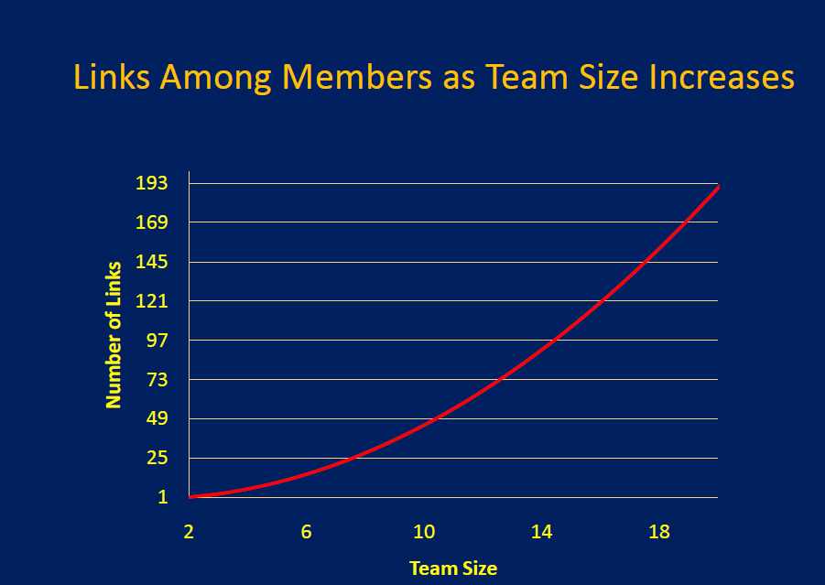
Notes:
“Another fallacy is the bigger teams are better than small ones because they have more resources to draw upon. A colleague and I once did some research showing that as the team gets bigger, the number of links that need to be managed among members goes up at an accelerating, almost exponential rate. It’s managing the links between members that gets teams into trouble. My rule of thumb is no double digits…. Big teams usually wind up just wasting everybody’s time.”
Hackman

Slide 42
Team Effectiveness Decision Tree
Is it a team?
Group?
Co-located individuals?
Is it successful?
Produces what the customers want?
Right conditions?
Right People
Able to do it again and again; can take their methods and profitably apply them to other tasks?
Does so in a way that makes the members of the team feel good?
Status mob?
Enabling Structure
Compelling Direction
Supportive Organizational Context
Part of the enabling structure is the process

Slide 43
Fact # 4: Face-to-face interaction is passé.
Notes:
HBR Hackman
Teams working remotely are at a considerable disadvantage. There really are benefits to sizing up your teammates face-to-face. A number of organizations that rely heavily on distributed teams have found that it is well worth the time and expense to get members together when the team is launched, again around the midpoint of the team's work, and yet again when the work has been completed.

Slide 44
Fact # 5: It takes clear, specific, and incentivized objectives to focus and motivate teams.

Slide 46
Fact # 6: Harmony helps
Notes:
HBR Hackman
Quite the opposite, research shows. Conflict, when well managed and focused on a team's objectives, can generate more creative solutions than one sees in conflict-free groups. So long as it is about the work itself, disagreements can be good for a team. Indeed, we found in our earlier research on symphony orchestras that slightly grumpy orchestras played a little better as ensembles than those whose members worked together especially harmoniously.

Slide 47
The utility of a ‘deviant’ in a team setting
[I play that role at times]
We’re talking about a deviant not a derailer

Slide 48
Fact # 7: Smart members generate smart products
Notes:
http://www.nytimes.com/2008/01/08/science/08conv.html
In your book you posit that organizations made up of different types of people are more productive than homogenous ones. Why do you say that?
A. Because diverse groups of people bring to organizations more and different ways of seeing a problem and, thus, faster/better ways of solving it.
People from different backgrounds have varying ways of looking at problems, what I call “tools.” The sum of these tools is far more powerful in organizations with diversity than in ones where everyone has gone to the same schools, been trained in the same mold and thinks in almost identical ways.
The problems we face in the world are very complicated. Any one of us can get stuck. If we’re in an organization where everyone thinks in the same way, everyone will get stuck in the same place.
But if we have people with diverse tools, they’ll get stuck in different places. One person can do their best, and then someone else can come in and improve on it. There’s a lot of empirical data to show that diverse cities are more productive, diverse boards of directors make better decisions, the most innovative companies are diverse.
Breakthroughs in science increasingly come from teams of bright, diverse people. That’s why interdisciplinary work is the biggest trend in scientific research.
The term “diversity” has become a code word for inclusion of racial, ethnic and sexual minorities. Is that what you’re talking about?
Scott Page
Then from Hackman in http://bklists.blogspot.com/2011/04/five-collaborative-tactics-that-dont.html
Expertise by itself is insufficient. If a team is to be successful, all members need to have at least modest capability in working collaboratively with others. Besides, if needed expertise does not exist within the team, members always can seek it from outsiders.
A. I mean differences in how people think. Two people can look quite different and think similarly. Having said that, there’s certainly a lot of evidence that people’s identity groups — ethnic, racial, sexual, age — matter when it comes to diversity in thinking.
Here’s the bottom line: I myself am an affirmative action child. I got into the University of Michigan in the 1980s on a program. I’m from a rural part of Michigan. No calculus in high school. So I was given bonus points toward undergraduate admissions.
If the policy had been to consider mainly grades and SATs and not to make room for some geographic diversity, maybe I wouldn’t have gotten in.

Slide 50
Diversity might mean turning distribution of power upside down
The main point … is that any breakthrough innovation, reverse or otherwise, requires special teams that are custom-built from scratch. When building such a team, be sure to:
Start hiring by asking What skills do we need?, not Who do we know? or Who is available?
Create custom titles and job descriptions, tailored to the task at hand.
Deliberately shift the power structure, as the task at hand requires. [Reverse the pecking order]
Breakthrough innovation is not just about ideas. It's about getting unfamiliar work done, and unfamiliar work requires unfamiliar teams.
Chris Trimble
Notes:
From HBR
The main point of this post is that any breakthrough innovation, reverse or otherwise, requires special teams that are custom-built from scratch. When building such a team, be sure to:
Start hiring by asking What skills do we need?, not Who do we know? or Who is available?
Create custom titles and job descriptions, tailored to the task at hand.
Deliberately shift the power structure, as the task at hand requires.
Breakthrough innovation is not just about ideas. It's about getting unfamiliar work done, and unfamiliar work requires unfamiliar teams.

Slide 52
Fact #8: The more information, the better
Notes:
HBR Hackman
Teams sometimes drown in data. Large quantities of information don’t always help clarify a murky situation. Indeed, more data sometimes actually makes it harder to figure things out. It’s not the amount of information that counts, it is the choice about what information the team gets and uses that can spell the difference between success and failure.

Slide 53
Fact #9: Teamwork is magical
Notes:
HBR Hackman
It takes careful thought and no small about amount of preparation to stack the deck for success. The best leaders provide a clear statement of just what the team is to accomplish, and they make sure that the team has all the resources and supports it will need to succeed. Although you may have to do a bit of political maneuvering to get what is needed for effective collaboration from the broader organization, it is well worth the trou

Slide 54
Fact #10: It all depends on the leader
(The Leader Attribution Error)
Notes:
HBR Hackman
The hands-on activities of group leaders do make a difference. But the most powerful thing a leader can do to foster effective collaboration is to create conditions that help members competently manage themselves. The second most powerful thing is to launch the team well. And then, third, is the hands-on teaching and coaching that leaders do after the work is underway. Our research suggests that condition-creating accounts for about 60% of the variation in how well a team eventually performs; that the quality of the team launch accounts for another 30%; and that real-time coaching accounts for only about 10%. Leaders are indeed important in collaborative work, but not in the ways we usually think.

Slide 55
Responsibilities of team members
Take action (including political action if needed) to get the six conditions in place for your team.
Continuously monitor your team’s work processes (see next slide and handout).
Take remedial action to minimize process losses, and leadership initiatives to create process gains.

Slide 56
Ground Rules for Teams
The Six Conditions of Effectiveness
Real Team
Right People
Enabling Structure
Compelling Direction
Supportive Organizational Context
Expert Coaching
Leadership does matter, but how much?
DOCUMENTATION MATETRS!!!
Notes:
http://team-diagnostics.com/the-model.php
The team must be a real team, rather than a team in name only; it has compelling direction for its work; it has an enabling structure that facilitates teamwork; it operates within a supportive organizational context; and it has expert teamwork coaching.

Slide 57
What Does ‘Process’ Include?
Leadership
Conflict Management
Sense Making
Decision-Making
Boundary Management

Slide 58
Role of the Team Leader
Decide whether or not you really need a team.
Get the essential and enabling condition sin place—and keep them there.
Coach at the marginsto help the team take full advantage of its favorable performance circumstances.

Slide 61
Coaching By Itself Is Not Enough
Bad coaching hurts poorly designed teams, but does not significantly impair well-designed teams.
Competent team coaching greatly helps well-designed teams, but does not help poorly designed teams.
Notes:
Wageman, R. (2001). How leaders foster self-managing team effectiveness: Design choices
versus hands-on coaching. Organization Science, 12, 559-577.
31

Slide 62
Leaders create conditions for team effectiveness
Leaders who succeed:
need to know some things;
need to know how to do some things;
need an above-average level of emotional maturity and political acumen.
J. Richard Hackman
Notes:
http://hbswk.hbs.edu/archive/2996.html
Leaders who succeed in creating conditions for team effectiveness, one, need to know some things; two, need to know how to do some things; and three, need an above-average level of emotional maturity and political acumen.
J. Richard Hackman Need to know some things. As I point out in my book, a great deal of conventional wisdom about what it takes to foster team effectiveness is, to put it bluntly, wrong. Most of us believe that "harmony helps performance," for example, or that "bigger is better," or that "teams need a constant flow-through of new members to stay fresh." Our research findings provide an alternative to conventional wisdom, one that views the leader's job as, first of all, getting those five conditions in place, and then doing whatever the leader can do to strengthen them and to help teams take good advantage of them.
This requires some depth of knowledge about what those conditions are and why they provide a solid platform for group development and performance.
Need to know how to do some things. There are real skills involved in creating the key conditions for effectiveness. For example, take "establish a compelling direction for the team." Creating this condition requires much more than merely writing out a vision statement and giving it to the team. Leaders often err either by giving teams too much direction (for example, telling them not only what they are to accomplish but all the details about how they are to go about accomplishing it) or too little (for example, giving merely a vague description of the team's purposes and leaving it to the team to "work out the details"). Setting good direction for a team means being authoritative and insistent about desired end states, but being equally insistent about not specifying how the team should go about achieving those end-states. This requires some skill and, unfortunately, it is not the kind of skill commonly taught in MBA classrooms or executive leadership programs. Similar skill requirements also hold for the other four conditions.
Emotional maturity and political acumen. One usually cannot establish the conditions for effectiveness on the leader's own schedule. Trying to force a condition when the time is not right almost never works. This means that leaders, like hungry lions, must lie in wait for the right time—and then, when it is right, pounce. To wait for the right time, especially when things seem to be getting worse rather than better, requires no small measure of emotional maturity.
Sometimes there is no prospect that organizational circumstances will become more amenable to creating the key conditions. In those circumstances, leaders must draw on their political skills—identifying the people or groups whose cooperation is needed to move forward, and then finding ways to get their interests aligned with the leader's own so that constructive change can begin. In the book, I give lots of examples of how leaders in various industries have done this while still maintaining their personal and professional integrity.

Slide 63
Supportive Context
“The leader’s first priority, then, is to identify those specific structures and systems that are most critical to team effectiveness and therefore worthy of focused attention and possible intervention. Findings from research on the organizational context of work teams can be helpful in this regard.
… Three organizational systems have particularly high leverage in supporting teamwork: the reward system, the information system, and the educational system.”

Slide 64
Notes:
In case, you are unfamiliar with Hackman, his model sets the five necessary conditions for team effectiveness as follows:
A so-called real team has these four features: a team task, clear boundaries, clearly assigned authority to make team decisions, and membership stability.
Possessing a compelling direction refers to whether the team has clear, challenging, and consequential goals that focus on the ends to be accomplished rather than the means the team must use to pursue them.
An enabling structure refers to whether the team’s task, composition, and norms of conduct enable rather than impede teamwork.
“People have internal motivation when they view their work as meaningful and feel personally responsible for work outcomes and receive trustworthy knowledge of the results of their efforts.”
Supportive organizational context refers to whether the team receives adequate resources, rewards, information, education, intergroup cooperation, and support that members need to accomplish their tasks.
And the sixth is the right people

Slide 65
Team Effectiveness Decision Tree
Is it a team?
Group?
Co-located individuals?
Is it successful?
Produces what the customers want?
Right conditions?
Right People
Able to do it again and again; can take their methods and profitably apply them to other tasks?
Does so in a way that makes the members of the team feel good?
Status mob?
Enabling Structure
Compelling Direction
Supportive Organizational Context

Slide 66
Appendix
Links and more

Slide 67
Takeaway
Focus less on direct causes of team behavior and performance and more on enabling conditions.

Slide 68
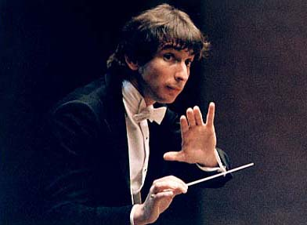
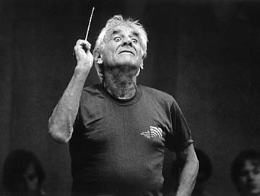
And do it all in one's own way--there is no one best leader personality or strategy.

Slide 69
GROUP PROCESS CHECKLIST
How are our team processes?
What actions might we take to
Improve our team processes?
A B C D F
excellent
so-so
flunk
Effort
EFFORT AND COMMITMENT
Possible Actions…
Avoiding process losses:
___ No “social loafing” by team members
Building synergy:
___ Team builds high shared commitment
to the team and its work
Overall
TEAM PERFORMANCE STRATEGIES
Possible Actions…
Strategy
Avoiding process losses:
___ No mindless reliance on habitual
performance routines
Building synergy:
___ Active invention of innovative and
task-appropriate ways of proceeding
Overall
KNOWLEDGE AND SKILLS
Possible Actions…
Talent
Avoiding process losses:
___ No inappropriate “weighting’ of
member contribution
Building synergy:
___ Active teaching and learning among
group members
Overall

Slide 70
Facilitation: Process or Product

Slide 71
You only get one chance to make a first impression
“The first few minutes of the start of any social system are the most important because they establish not only where the group is going but also what the relationship will be between the team leader and the group, basic norms of behavior will be expected and enforced”
Hackman
The first meeting determines the success to a large degree

Slide 72
11 agreements for effective teams
Make reasoning transparent.
Solicit feedback; invite others to ask questions about what you say.
Put all your cards on the table.
Pay attention to what everybody needs from the solution before proposing solutions.
Be explicit; use as many examples as possible.
Work out the meaning of the words that matter most in the conversation.
Dissent in the room, not in the hallways.
Keep the discussion focused.
Be fully present — no slackers, no ‘vacations.’
Agree to the rules of the game before you roll the dice.
Review the above agreements on a regular basis.

Slide 73
Facilitation: process
Manage the debate
Make sure everyone knows the meeting’s purpose (making a decision) and the criteria you will be using to make that decision.
Ask participants to write down their initial positions, use voting devices, or ask participants for their “balance sheets” of pros and cons.
Use the premortem technique to expand the debate.
The premortem technique is a sneaky way to get people to do contrarian, devil’s advocate thinking,” explains psychologist Gary Klein. “Before a project starts, say, ‘We’re looking in a crystal ball, and this project has failed; it’s a fiasco. Now, everybody, take two minutes and write down all the reasons why you think the project has failed.”
Counter anchoring: postpone the introduction of numbers if possible; “reframe” alternative courses of action as they emerge by making explicit “what you have to believe” to support each of the alternatives.
Pay attention to the use of comparisons and analogies: limit the use of inappropriate ones
Force the room to consider opposing views. For vital decisions, create an explicit role for one or two people—the “decision challengers.”
“Frankly, I’m surprised that when you have a reasonably well-informed group it isn’t more common to begin by having everyone write their conclusions on a slip of paper,” remarks Nobel laureate Daniel Kahneman. “If you don’t do that, the discussion will create an enormous amount of conformity.”
Notes:
Manage the debate is from https://www.mckinseyquarterly.com/Taking_the_bias_out_of_meetings_2561
Manage the debate
Before you get going, make sure everyone knows the meeting’s purpose (making a decision) and the criteria you will be using to make that decision. For recurring decisions (such as R&D portfolio reviews), make it clear to everyone that those criteria include “forcing devices” (such as comparing projects against one another).
Take the pulse of the room: ask participants to write down their initial positions, use voting devices, or ask participants for their “balance sheets” of pros and cons.
“Frankly, I’m surprised that when you have a reasonably well-informed group it isn’t more common to begin by having everyone write their conclusions on a slip of paper,” remarks Nobel laureate Daniel Kahneman. “If you don’t do that, the discussion will create an enormous amount of conformity.” (See “Strategic decisions: When can you trust your gut?”)
“Put together a simple balance sheet where everybody around the table is asked to list points on both sides: ‘Tell me what is good about this opportunity; tell me what is bad about it. Do not tell me your judgment yet. I don’t want to know,’” says Randy Komisar, partner at Kleiner Perkins Caufield & Byers. “The balance sheet process mitigates a lot of the friction that typically arises when people marshal the facts that support their case while ignoring those that don’t. (See “Kleiner Perkins’ Randy Komisar: ‘Balance out biases.’”)
Use the premortem technique to expand the debate.
“The premortem technique is a sneaky way to get people to do contrarian, devil’s advocate thinking,” explains psychologist Gary Klein. “Before a project starts, say, ‘We’re looking in a crystal ball, and this project has failed; it’s a fiasco. Now, everybody, take two minutes and write down all the reasons why you think the project has failed.” (See “Strategic decisions: When can you trust your gut?”)
Counter anchoring: postpone the introduction of numbers if possible; “reframe” alternative courses of action as they emerge by making explicit “what you have to believe” to support each of the alternatives.
“It’s easy for people to lose track of how much they’ve explained away,” notes Klein. “So one possibility is to try to surface this for them—to show them the list of things they’ve explained away.” (See “Strategic decisions: When can you trust your gut?”)
Pay attention to the use of comparisons and analogies: limit the use of inappropriate ones (“inadmissible evidence”) by asking for alternatives and suggesting or requesting additional analogies.
Force the room to consider opposing views. For vital decisions, create an explicit role for one or two people—the “decision challengers.”

Slide 74
Transfer of learning
How will your understanding of ‘team’ change the way you approach work situaitons?
What difference would your knowlwdge structure make to chices of team, work unit, or co-located individuals?
What sugegstions would you make to form the team with the best chance for success?
How would you lead such a team?
What guidelines to the effective facilitation of a team for process and product might you apply in the next week?

Slide 75
Two Books

Slide 76
Links
http://www.fas.org/irp/dni/isb/analytic.pdf
http://www.leadingteams.org/open/index3.htm
Turn your epcking orde upside down
http://blogs.hbr.org/cs/2012/05/to_innovate_turn_your_pecking_order_upside_down.html

Slide 77
Rating Group Effectiveness
T.J. Elliott
from Edgar Schein

Slide 78
Rating Group Effectiveness
GOALS
Poor 1 2 3 4 5 Good
PARTICIPATION
Poor 1 2 3 4 5 Good
FEELINGS
Poor 1 2 3 4 5 Good
DIAGNOSIS OF GROUP PROBLEMS
Poor 1 2 3 4 5 Good
LEADERSHIP
Poor 1 2 3 4 5 Good
DECISIONS
Poor 1 2 3 4 5 Good
TRUST
Poor 1 2 3 4 5 Good
CREATIVITY AND GROWTH
Poor 1 2 3 4 5 Good

Slide 79
Rating Group Effectiveness
GOALS
Poor 1 2 3 4 5 Good
Confused, diverse Clear to all,
conflicting, indifferent, shared by
little interest all, all care
about the
goals, feel
involved
PARTICIPATION
Poor 1 2 3 4 5 Good
Few dominate, some All get in,
passive, some not listened to, all are really
several talk at once listened to
or interrupt
FEELINGS
Poor 1 2 3 4 5 Good
Unexpected, ignored Freely expressed,
or criticized empathic responses

Slide 80
Rating Group Effectiveness
DIAGNOSIS OF GROUP PROBLEMS
Poor 1 2 3 4 5 Good
Jump directly to When problems
remedial proposals, arise the situation
treat symptoms is carefully dx’ed
rather than basic causes before action is
proposed, remedies
attack basic causes
LEADERSHIP
Poor 1 2 3 4 5 Good
Group needs for As need for
leadership not met, leadership arise
group depends too much various members
on single person or meet them
on a few persons (“distributed
leadership”);
anyone feels free to
volunteer as he/she
sees a group need

Slide 81
Rating Group Effectiveness
DECISIONS
Poor 1 2 3 4 5 Good
Needed decisions Consensus sought
don’t get made, decision and tested;
made by part of group; deviates appreciated
others uncommitted and used to improve
decisions; decisions
when made are
fully supported
TRUST
Poor 1 2 3 4 5 Good
Members distrust one Members trust
another, are polite, one another; reveal
careful; closed, guarded; to group what they
they listen superficially would be reluctant
but inwardly reject to expose to others;
what others say; are afraid they respect and use
to criticize or be criticized the responses they
get; they can freely
express negative
reactions without
fearing reprisal

Slide 82
Rating Group Effectiveness
CREATIVITY & GROWTH
Poor 1 2 3 4 5 Good
Members and group Group flexible,
in a rut, operate seeks new and better
routinely; persons ways; individuals
stereotyped and rigid changing and
in their roles; growing; creative;
no progress individually
supported.

Slide 83
Different kinds of teams and one that’s not quite a team
Co-acting groups
F2F teams
Virtual teams
Sand Dune teams

Slide 84
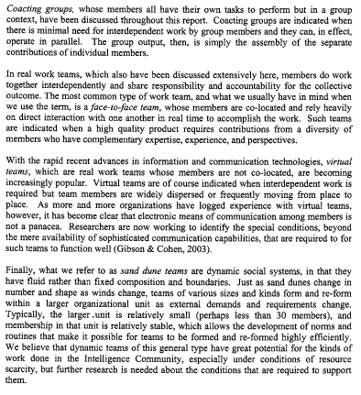

Slide 85
Hackman Team Model
In case, you are unfamiliar with Hackman, his model sets the five necessary conditions for team effectiveness as follows:
A so-called real team has these four features: a team task, clear boundaries, clearly assigned authority to make team decisions, and membership stability.
Possessing a compelling direction refers to whether the team has clear, challenging, and consequential goals that focus on the ends to be accomplished rather than the means the team must use to pursue them.
An enabling structure refers to whether the team’s task, composition, and norms of conduct enable rather than impede teamwork.
“People have internal motivation when they view their work as meaningful and feel personally responsible for work outcomes and receive trustworthy knowledge of the results of their efforts.”
Supportive organizational context refers to whether the team receives adequate resources, rewards, information, education, intergroup cooperation, and support that members need to accomplish their tasks.
And the sixth is the right people
Notes:
Motivation note is from http://www.leadingteams.org/pdfs/chpt04C.pdf

