Slide 1




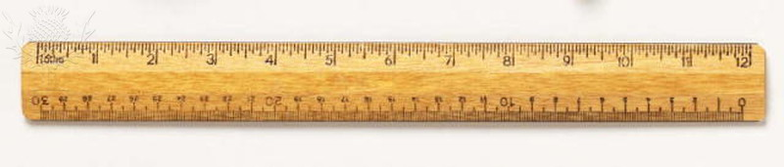





Ten Tools
A collection of organizational and individual methods to aid effectiveness

Slide 2

How do I add value?
How do I now what to do?
How do I know where to spend my time?
How do I know how to get things done?

Slide 3
How do I…
Know what to do?
  Gap analysis
  Sensemaking
  Ideal-setting
Get things done?
  Collaboration
  Performance
Nurture and enhance relationships?
  Collaboration
  Communication
Develop myself?
  Personal mastery
  Gap Analysis
  Sensemaking
Move people and their behavior from point A to point B?
  Gap analysis
  Influence
  Performance
Lead teams to produce desired results?
  Collaboration
  Performance
  Facilitation
Solve problems?
  Sense making
  Evaluation
  Performance
Notes:
The 10 tools are a set of ways of looking at the world in situations so as to be more effective. All of us at work are confronted with questions – if we bothered to be aware and we care about being successful – that need answers. And those answers must be more than mere prescriptions; those answers must contain within them the means by which we can make things different. The 10 tools are way for us to know more clearly what to do, to get things done more efficiently and more effectively with less breakdowns, to improve and strengthen our relationships that are critical to the success of any individual in any enterprise, to allow us to do capital C. change management, to lead teams to produce their objectives, and to solve problems.

Slide 4

Session 6
Mental Maps

Slide 5
Ten Tools
Atom of Work
Gap Analysis
Difficult Conversations
Mental Maps
Advocacy versus Inquiry
Feed Forward & Johari Window
Team Effectiveness
Problem-solving techniques
Seven Influence Strategies
Events of Instruction

Slide 6
Session | Date | Competencies
Atom of Work | 2/24/15 | Results orientation Relationship Mastery / People Skills
Gap Analysis | 3/18/15 | Results orientation Market and Customer Orientation/ Insight
Difficult Conversations | 4/7/15 | Results orientation Relationship Mastery / People Skills
Mental Maps | 5/28/15 | Results orientation Relationship Mastery / People Skills Market and Customer Orientation/ Insight Learning Agility
Advocacy versus Inquiry | 6/23/15 | Learning Agility Relationship Mastery / People Skills
Problem Solving | 7/29/15 | Results orientation Market and Customer Orientation/ Insight Learning Agility
Team Effectiveness | 8/25/15 | Results orientation Relationship Mastery / People Skills
Seven Influence Strategies | 9/29/15 | Results orientation Relationship Mastery / People Skills
FeedFoward and Johari Window | 10/27/15 | Relationship Mastery / People Skills
Events of Instruction | 11/30/14 | Learning Agility
(Bonus) Six steps | 12/10/14
Extra day hold
Notes:
Handout

Slide 7
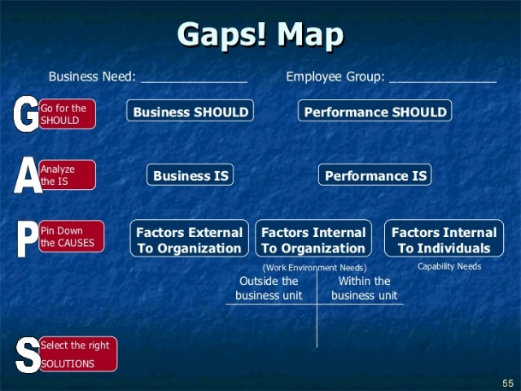
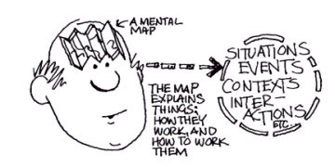
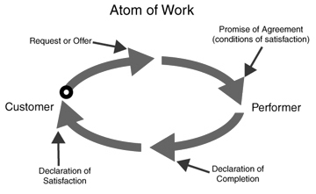
How Other Tools Fit With
Mental Maps
What
You Should Request
Agreeing on What 'Done' Looks like
Notes:
Handout

Slide 8

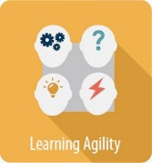

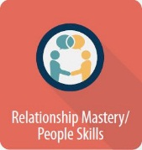
ETS Success Six Connections
Results Orientation
Delivering on promises and commitments: how do you know what the promise really is? What is your theory and ‘map’ leading to delivery?
Learning Agility
The mental map can be the reference point to determine what you have learned or experienced
Market Insight and Service Orientation
Understanding the “problem to be solved”: How do you know if others agree as to 'the problem’ and/or the way in which to reach a solution??
Relationship Mastery/People Skills
In building and sustaining relationships and networks, we need to develop skills to allow us to work effectively with individuals, teams, and entire units. Being able to depict not only your own mental map but helping others to convey their ideas of how things will get done is very useful

Slide 9
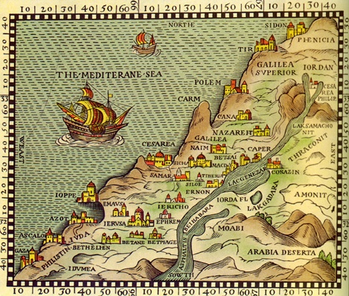
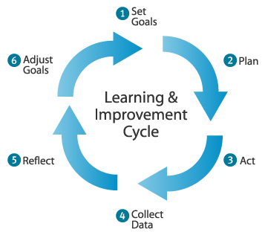
Mental Maps &
Theories of Action
Based on Clear Leadership by
Gervase Bushe

Slide 10
What Might You Gain From This Session?
Given a performance situation, you will
  Discriminate among a theory of action, a theory in use, and a mental map as schemes that underlie our operations in the world
  Understand the importance of understanding the different mental maps of participants that are the outcomes of their learning from experience
  Understand that since a well ingrained map is the platform for our awareness and sense making that it will influence interpretation even before behavior
  Understand how maps may cause problems as they focus our attention; we tend to see only what is on our maps and miss what isn‘t
  Draw a mental map using the cardwork technique and explain to others how they can do so as well

Slide 11
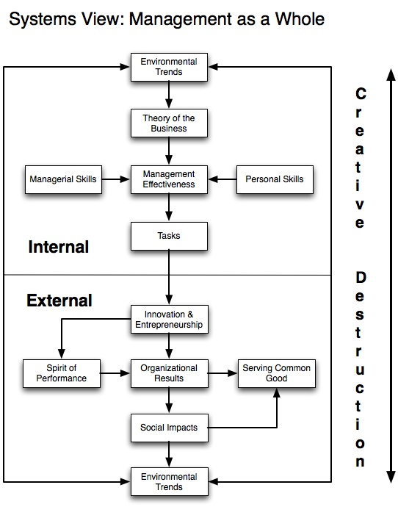
Can anyone interpret this mental map?
Notes:
Ask participants
Management As A System Of Interrelated Elements (Figure 1) Peter Drucker 1974
http://homepage.mac.com/bobembry/studio/biz/conceptual_resources/toc_reviews/conceptual_resources_files/management-rev-ed.html

Slide 12
What is this map born from?
A theory of how the world works ⎯ a theory of action
A desire to capture the way in which the theory operates in a model or map
A method for drawing such a map

Slide 13
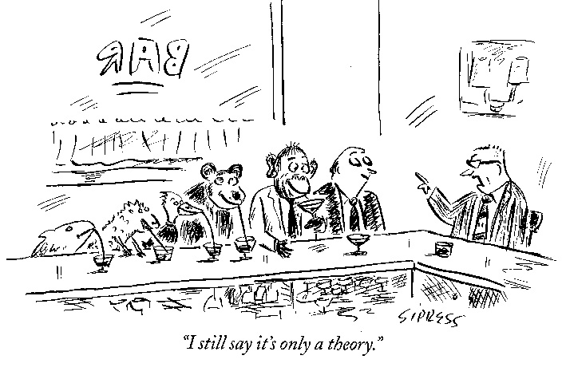
What do we mean by ‘a theory’?

Slide 14

What is a theory?
What should you do if you get lost in the wilderness?
What should you do when you get lost?
  Step 1 – Signal for Help
  Step 2 – Build a Fire
  Step 3 – Find Shelter
  Step 4 – Stay Warm
  Step 5 – Stay Put
Notes:
Ask participants

Slide 15
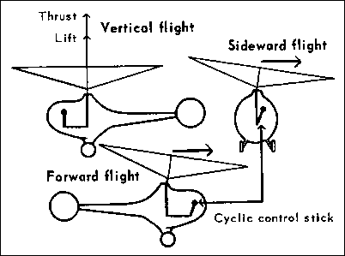
What is a theory?
A conception or mental scheme of something to be done, or of the method of doing it; a systematic statement of rules or principles to be followed
Notes:
Handout

Slide 16
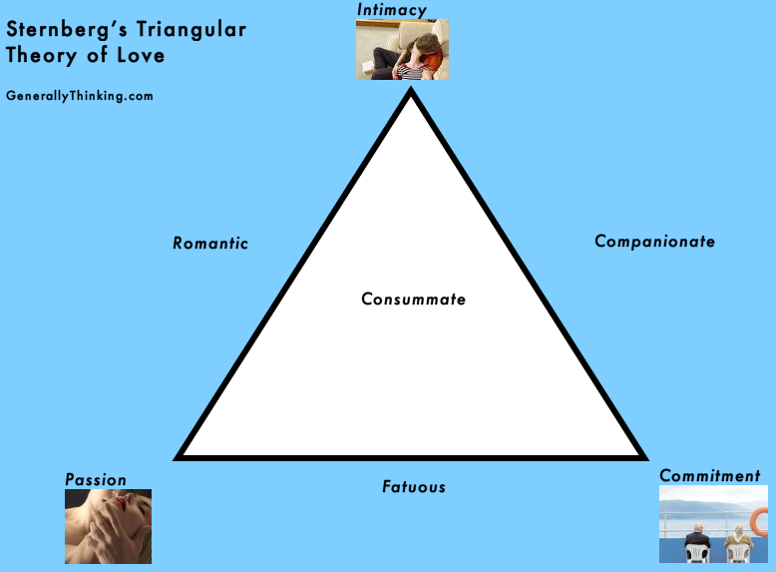
What is a theory?
“A conception or mental scheme of something to be done, or of the method of doing it; a systematic statement of rules or principles to be followed”
An idea of how things work
No aspects = Non-love
Intimacy + Passion = Romantic love
Intimacy + Commitment = Companionate love
Passion + Commitment = Fatuous love
Intimacy + Passion + Commitment = Consummate love

Slide 17

Who has an example of a theory that we use at work?
Incentives
Project Management
Communication
  Meeting
Management By Objective (MBO)
Change Management
Matrix Organization
even
Fairness, competencies, how to be successful ⎯ they are all theories
Notes:
Ask participants

Slide 18
Drucker's Theory Of Business
Drucker's Theory Of Business consists of three parts:
  (1) assumptions about the environment of the organization,
  (2) assumptions about the specific mission of the organization, and
  (3) assumptions about the core competencies needed to accomplish the organization's mission
  If we walk around with some combo of those three rattling in our brains they drive our behavior, shape perceptions

Slide 19
Drucker's TOB maps out in this way. Environment, core competencies, and mission intermingle
Notes:
We see how assumptions about the environment of the organization, about the specific mission of the organization, and about the core competencies needed to accomplish the organization's mission. The map shows what would take many words to describe.

Slide 20
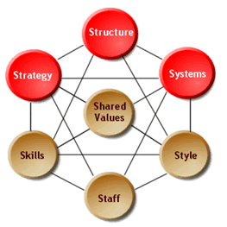
Competing Maps:
How Are They Different?
Drucker TOB
McKinsey 7S
Notes:
Handout
Developed in the early 1980s by Tom Peters and Robert Waterman, two consultants working at the McKinsey & Company consulting firm, the basic premise of the 7S model is that there are seven internal aspects of an organization that need to be aligned if it is to be successful.

Slide 21
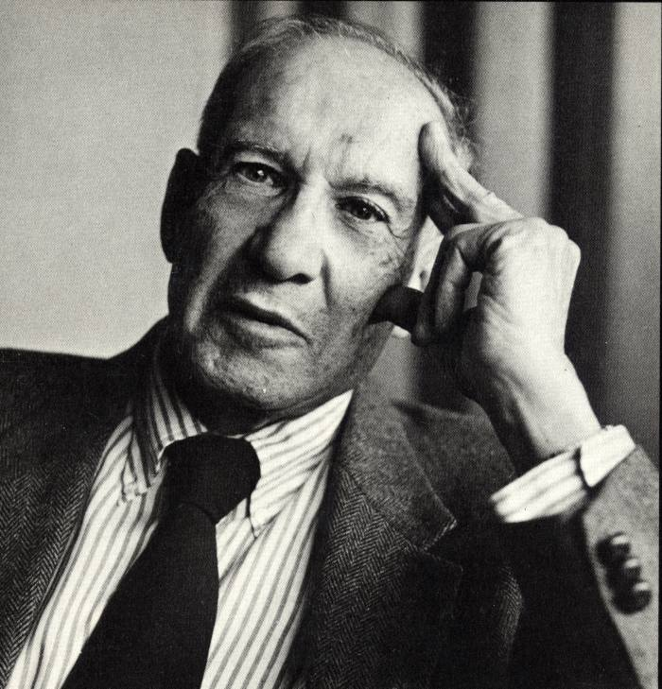
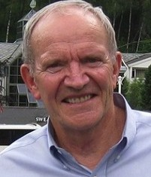

Different Mental Maps
Notes:
It's not that one mental map is better than the other. The purpose of depicting and then comparing mental maps is not to demonstrate superiority, but rather to gain clarity. In fact, there may be opportunities to combine elements into an integrated and more valuable map, one that guides more effective action

Slide 22
Drucker’s Four Specifications
Of A Valid Theory Of Business
The assumptions about environment, mission, and core competencies must fit reality.
The assumptions in all three areas have to fit one another.
The theory of business must be known and understood throughout the organization.
The theory of business has to be tested constantly.
What is ETS’s TOB?
Notes:
Ask participants

Slide 23
Theory Matters For Organizations
“What underlies the malaise of so many large and successful organizations is that their theory of the business no longer works.”
How would you know unless you asked people to make the TOB explicit?
Drucker outlined that while assumptions about the environment define what an organization is paid for, the assumptions about core competencies define where an organization must excel in order to maintain leadership. Assumptions about the mission define what is meaningful.

Slide 24
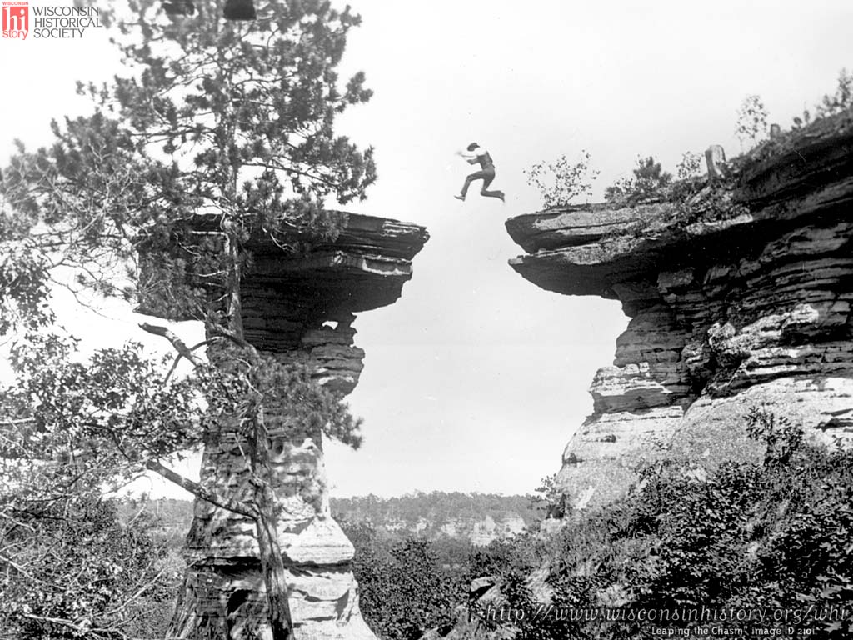
Theory matters for individuals too!!
or

Slide 25
You see a situation and create a scheme for dealing with it

Slide 26

You apply a conception or mental scheme of something to be done,
A Theory of Action
or of the method of doing it; a systematic statement of rules or principles to be followed
Notes:
Handout

Slide 27
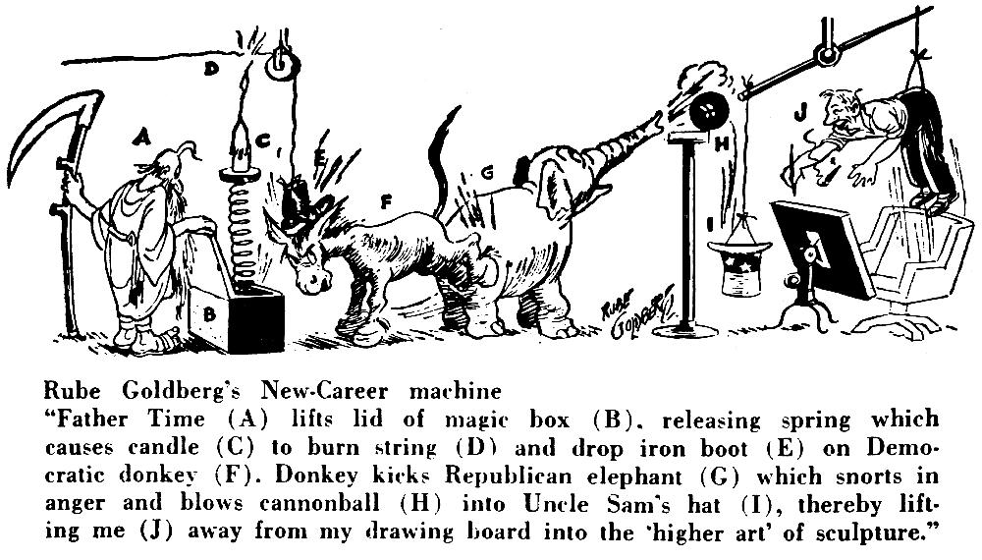
Theory of Action: how to act in situations in order to get what we desire

Slide 28
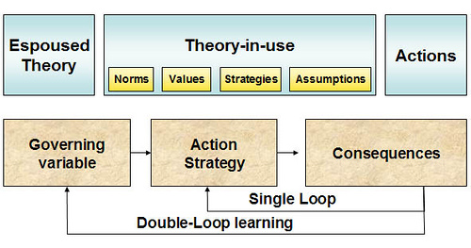
So we walk around applying theories all day long…
There’s the theory we SAY we’re following and there’s the theory that our actions show we are following or Theory-In-Use

Slide 29

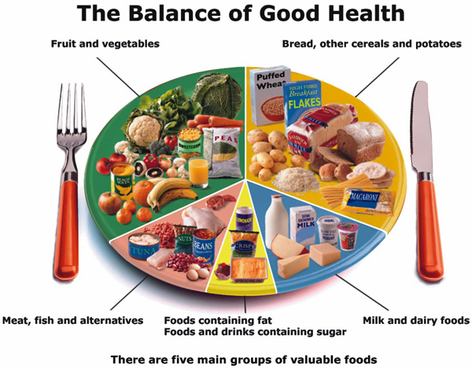
The difference between what we say and what we do
Theory Espoused
Theory-In-Use
Notes:
Handout
The term “espoused theory” means the theory of action which is claimed to explain or justify a given pattern of activity. The “theory-in-use” however, is a tacit theory of action implicit in the performance of the actual activity. (Argyris and Schön, 1996, p.13) As shown in Figure 1, this theory is driven by cultural norms, values, strategies and assumptions. This theory-in-use must be discovered through observation. The consequences of an activity are seen as a result of the espoused theories, seen as governing variables, as modified by the often tacit action strategy based on the theory-in-use.

Slide 30
Does Our Mental Map Show Espoused Theory
Or Theory-in-use?
If the mental maps of people describe how they act in situations, the way they plan, implement and review their actions, do they show the theories they explicitly espouse or the ones that are automatic?
Are people aware of the maps or theories they do use?
We won’t know until we draw, share, and discuss the maps

Slide 31

Why would it be important to expose our theories to each other?
Notes:
Ask participants

Slide 32
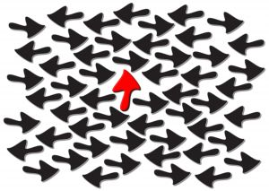
Would it help to see how our theory compares to others?
Notes:
Ask participants

Slide 33

How do we show our theories to each other?

Slide 34

Why Is Drawing A Mental Map Critical?
“Not checking out the validity of our maps is just another form of interpersonal mush.
Whether it's about people, tasks, or processes, the maps of people who work together can be inaccurate, invalid, out of sync, dissimilar, or at cross purposes.
So we need to put our maps on the table, look at them together, see what is causing us problems, and change our maps when that is appropriate.”
  Gervase Bushe
Notes:
Handout

Slide 35
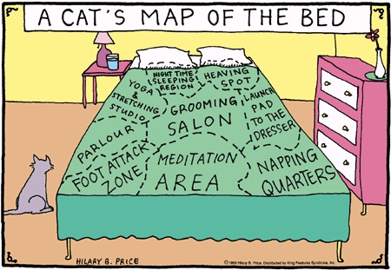
A well ingrained map is the platform for our awareness and sense making

Slide 36
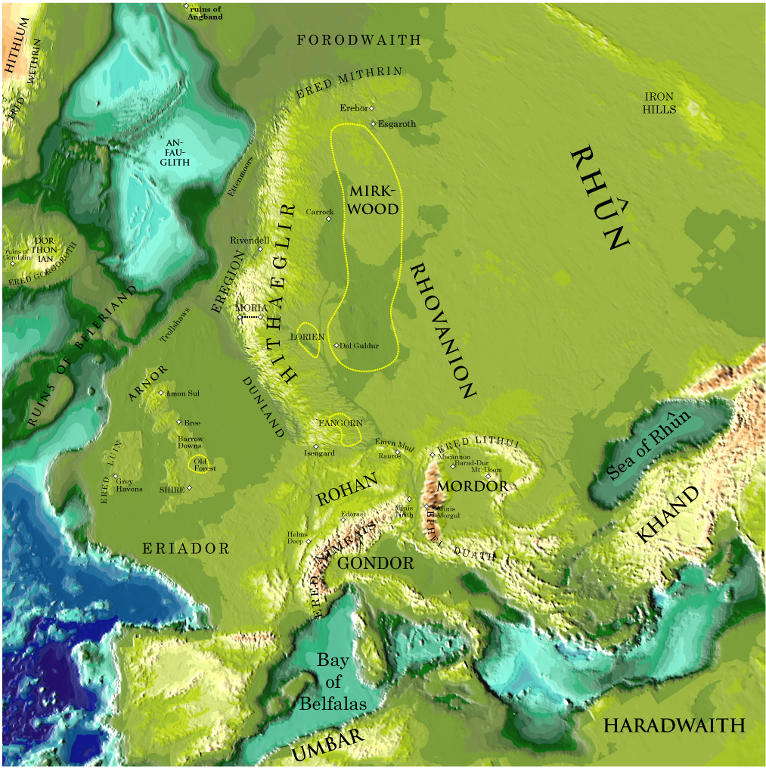
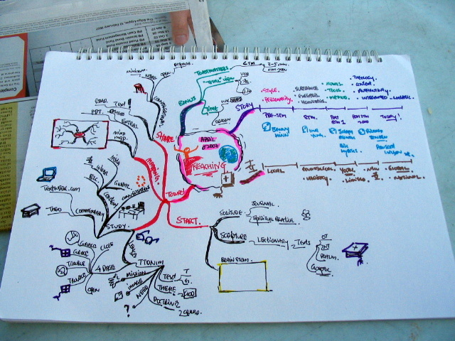
All kinds of maps can help

Slide 37

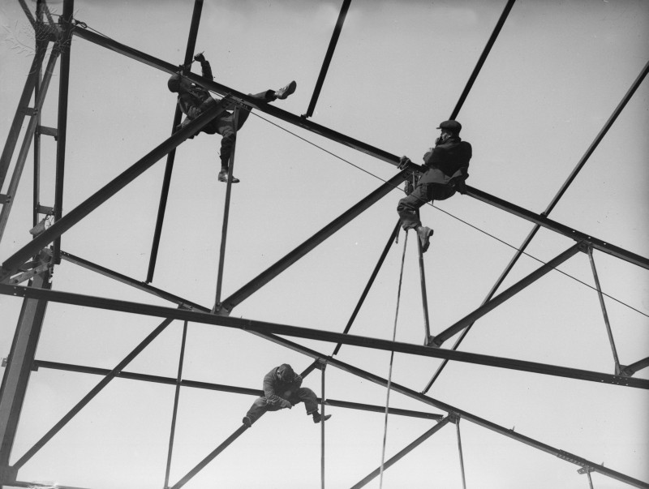
Every Time We Enter A New Situation We Begin Building A Map Of It.
“Every time we enter a new situation we begin building a map of it.
When we are first developing a map we are pretty conscious of what we are doing.
Whether it's learning how to solve business problems, deal with problem employees, or get good job interviews, we learn as much or more from our failures as from our successes as we slowly build maps that help us to succeed at what we are trying to accomplish.”
Gervase Bushe

Slide 38


A Mental Map May Allow Us To See the Forest AND the Trees
“Once we get a map that works for us, and we use it over and over again, it tends to recede into the background, out of awareness.
After awhile we don't even recognize that we are operating from a map.”
Gervase Bushe
We fail to recognize the elements of the map that we built: we can’t see the trees for the forest

Slide 39
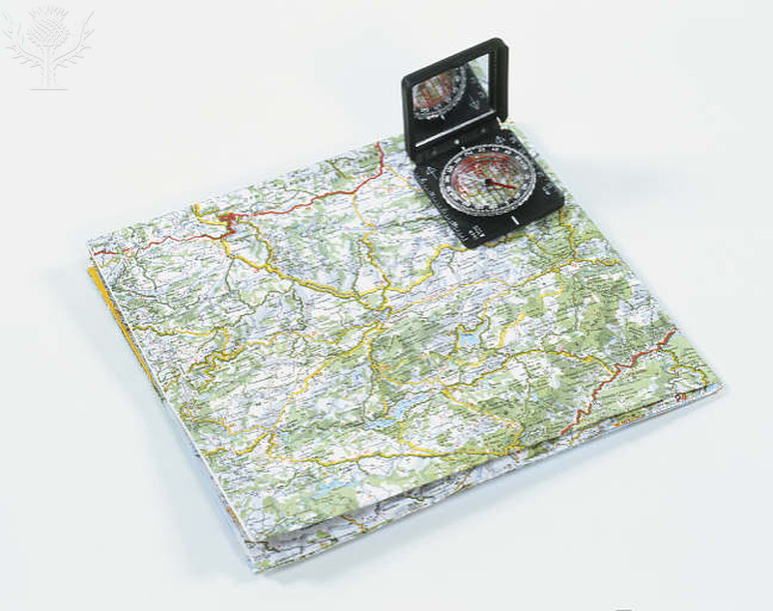
We should ‘talk the walk’
Its opposite is more popular, but ‘talk the walk’ means that we explain what we think we are doing and why the method chosen is the right one
We expose our ‘theory of action’
We unfold our mental map

Slide 40
Maps Can Be Useful or Harmful
“The maps also cause problems because they focus our attention. We tend to see only what is on our maps and miss what isn't.
When the map is invisible to us, and we are confused with reality, it distorts our perceptions and can cause us to see people doing things they didn't do and hear them saying things they didn't say, and causes us not to see things they did do and not to hear things they did say.”
  Gervase Bushe
Notes:
Handout

Slide 41

If I think my map is the reality I won't be interested in hearing about alternative maps
“Others will see me as having strong opinions about the way things are. If I'm the boss I'll probably make it uncomfortable for others to describe alternative maps -- thus decreasing organizational effectiveness and increasing interpersonal mush.”

Slide 42
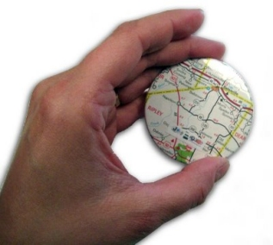
Identifying With Your Maps
“… people can identify with their maps and hold onto them pretty tenaciously. When I identify with my maps, I can choose who I am with them. One of the reasons for resistance to changes is that change often requires a new map for success.
When the environment changes so that maps the people are identified with no longer work, many will first try to change the situation back so that their old maps will continue to work.
Attempts to call for more rules and regulations in groups, organizations, or nations are almost always motivated by this kind of resistance: ‘Please re-create the old world we know how to succeed in.’”

Slide 43
Three Kinds of Maps
The stories we make up about each other.
  how they think, what they want, what they like and dislike, their biases and hot buttons, and so on.
  open to a lot of distortion, bias, and inaccuracy, so it's very important not to confuse your maps of them to the territory
An identity map: it identifies what things are at work
  what the goals are, who has what role, what those rules are, what success is, what quality is, what customer satisfaction is, and so on
  gain their validity because a large enough number of people hold that same map ⎯ inter-subjective truth.
Notes:
There are three kinds of maps that are referred to again and again in this book. The first is the stories we make up about each other. We develop maps about each of the significant people we work with that include how they think, what they want, what they like and dislike, their biases and hot buttons, and so on. We've already explored this one in a lot of detail. Your stories of people are open to a lot of distortion, bias, and inaccuracy, so it's very important not to confuse your maps of them to the territory to stay open to being surprised by who they really are. When you are and aware Southeast they open to seeing reports of people that aren't on your map. A second kind of map I call an identity map: it identifies what things are at work people have identity maps about what the goals are, who has what role, what those rules are, what success is, what quality is, what customer satisfaction is, and so on. I have a map of clear leadership: it's composed of the four skills I'm describing in this book. For the most part identity maps gain their validity because a large enough number of people hold that same map. Identity maps are an example of inter-subjective truth. Whether or not my map of the team's goals is accurate depends on how similar my map is to other people's old maps....

Slide 44
The third map: cause and effect
Let’s draw a few
Ideas we have about cause and effect: how to make things happen, how to accomplish tasks and goals.
Every goal oriented action we take is based on some theory we have of how that action will lead to that goal; we may be fully aware of our theory or not, but it is there.
If we are trying to accomplish a goal together it's helpful to be operating from a common theory of action....

Slide 45
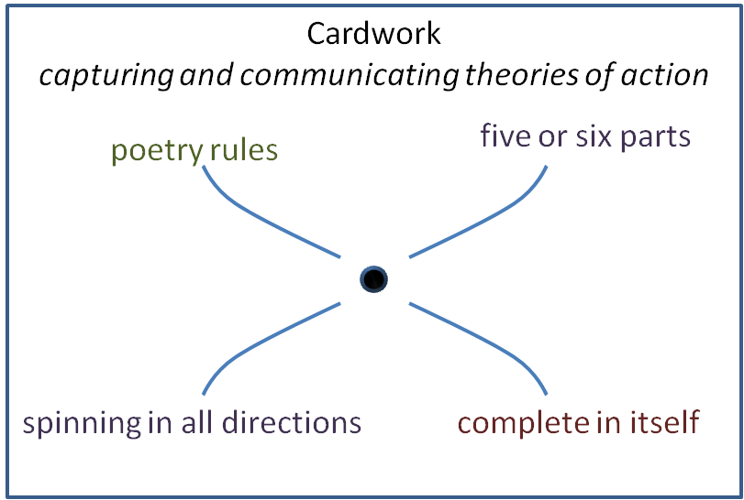
Cardwork…
Mental map of 'card work'
is about making your identity maps and theories of action explicit so that they can be described, discussed, and tested.
is a way of getting clear about other people's maps.
is a great way to practice getting clarity about theories of action even if you don't explicitly use it at work
Notes:
Cardwork is about making your identity maps and theories of action explicit so that they can be described, discussed, and tested. It's also a way of getting clear about other people's maps. It's a great way to practice getting clarity about theories of action even if you don't explicitly use it at work.
Flow diagrams and critical path charts are one way of capturing a theory of action. They depict a series of activities toward some end. Cardwork is quite different. Well constructed cards for the following characteristic, depicted in the card below.

Slide 46
Cardwork
Cardwork
capturing and communicating theories of action
five or six parts
complete in itself
spinning in all directions
poetry rules
Notes:
Handout

Slide 47
Cardwork Features
Five or six parts: a theory of action card has a title, a subtitle, and three or four phrases (never more than four) connected by a spinning, propeller like image.
Complete in itself; the title describes what this theory of action is about. The subtitle captures the outcome of successful action. The phrases provide a complete theory of how one reaches that outcome.
Spinning in all directions:
the phrases each capture a crucial facet of how one accomplishes the goal, task, or action, but they do not have to be in a linear, step-by-step sequence. Each phrase can itself "spin" and have more than one relevant meaning.
Notes:
Handout
Five or six parts: a theory of action card has a title, a subtitle, and three or four phrases (never more than four) connected by a spinning, propeller like image.
Complete in itself; the title describes what this theory of action is about. The subtitle captures the outcome of successful action. The phrases provide a complete theory of how one reaches that outcome.
Spinning in all directions: the phrases each capture a crucial facet of how one accomplishes the goal, task, or action, but they do not have to be in a linear, step-by-step sequence. Each phrase can itself "spin" and have more than one relevant meaning.

Slide 48
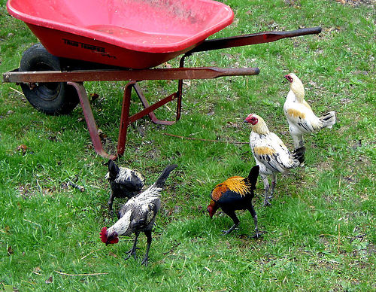
A Mental Map Is Like a Poem
so much depends
upon
a red wheel
barrow
glazed with rain
water
beside the white
chickens
Poetry rules: the title, subtitle, and phrases are constructed to evoke as many possible associations as are useful. Use wet, sticky, metaphorical language as opposed to dry, precise, intellectual language. A rule you can use for knowing when a card is completed is that, reading from the top right, it sounds like a poem

Slide 49
Then decide what the outcome of the effect of action is. If you're doing a card on “cardwork," what do you think that exercise produces? That is the subtitle. Here the subtitle is the effect of ‘cardwork’. (We hope!)
Pick a title
Cardwork
capturing and communicating theories of action
poetry rules
five or six parts
Next, brainstorm all the things you think are required from cardwork to produce that outcome. Once you are finished brainstorming, go back over the list and whittle it down. Combine similar ideas and eliminate redundant ones. Do this until you have whittled it down to no more than four key points.
spinning in all directions
complete in itself
Arrange these so the card reads more or less like a poem and then draw your card.
Notes:
From Bushe
I have found cardwork very useful in trying to understand my own and someone else's theory of action or identity map. An identity card is constructed the same way as a theory of action card but doesn't have a subtitle helping to make someone else's car usually leads us both to much deeper insight into their maps and helps to build good working relationships.
To practice, start by using cardwork to identify some of your own theories of action. A few good cards to start with are "leading teams," "influencing others," and "satisfying customers." Pick a title. Then decide what the outcome of the effect of action is. If you're doing a card on "leading teams," what do you think great team leadership produces? That is the subtitle. Next, brainstorm all the things you think are required from a leader to produce that outcome. Once you are finished brainstorming, go back over the list and whittle it down. Combine similar ideas and eliminate redundant ones. Do this until you have whittled it down to no more than four key points. Arrange these so the card reads more or less like a poem and then draw your card. If you find this useful, you may want to make a list of all the areas at work where you must be operating from a theory of action and make yourself a "deck" of cards.

Slide 50
Then decide what the outcome of the effect of action is. If you're doing a card on "leading teams," what do you think great team leadership produces? That is the subtitle. Here the subtitle is the effect of ‘leading teams’.
Pick A Title: The Subject Of Your Mental Map
Leading Teams
Turning a group of individuals into a cohesive productive unit
common fate
shared goals
Next, brainstorm all the things you think are required from a leader to produce that outcome. Once you are finished brainstorming, go back over the list and whittle it down. Combine similar ideas and eliminate redundant ones. Do this until you have whittled it down to no more than four key points.
all maps on the table
Fitting roles
Arrange these so the card reads more or less like a poem and then draw your card.
Notes:
Handout

Slide 51
Then decide what the outcome of the effect of action is. If you're doing a card on “solving wicked org’l problems," what do you think solving problems produces? That is the subtitle, the effect
Pick a title
Solving Wicked Organizational Problems
subtitle
Key point
Key point
Next, brainstorm all the things you think are required to produce that outcome. Once you are finished brainstorming, go back over the list and whittle it down. Combine similar ideas and eliminate redundant ones. Do this until you have whittled it down to no more than four key points.
Key point
Key point
Arrange these so the card reads more or less like a poem and then draw your card.

Slide 52
Then decide what the outcome of the effect of action is. If you're doing a card on “influencing others," what do you think that produces? That is the subtitle, the effect.
Pick A Title: The Subject Of Your Mental Map
Influencing Others At Work
subtitle
Key point
Key point
Next, brainstorm all the things you think are required to produce that outcome of influencing others at work. Once you are finished brainstorming, go back over the list and whittle it down. Combine similar ideas and eliminate redundant ones. Do this until you have whittled it down to no more than four key points.
Key point
Key point
Arrange these so the card reads more or less like a poem and then draw your card.
Notes:
Handout

Slide 53
Then decide what the outcome of the effect of action is. If you're doing a card on “career success“, what do you think career success produces? That is the subtitle.
Pick a title
Career Success
subtitle
Key point
Key point
Next, brainstorm all the things you think are required to produce that outcome. Once you are finished brainstorming, go back over the list and whittle it down. Combine similar ideas and eliminate redundant ones. Do this until you have whittled it down to no more than four key points.
Key point
Key point
Arrange these so the card reads more or less like a poem and then draw your card.

Slide 54
Influencing Others At Work
subtitle
Key point
Key point
Key point
Key point

Slide 55

How might you use cardwork to expose and compare mental maps?

Slide 56
What Will You Take Away
From Today?
Action
Map
Theory

Slide 57
Appendix
More slides related to action research

Slide 58
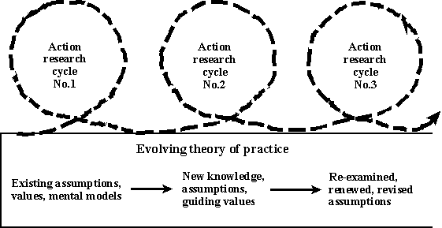
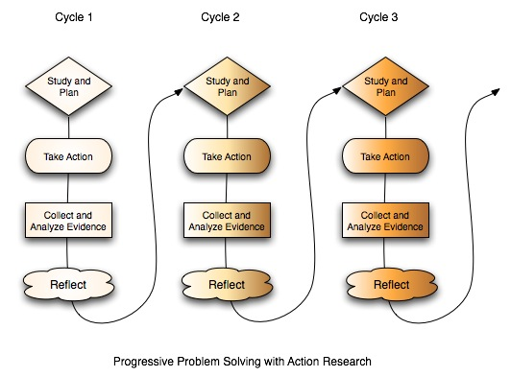
Action Research
Action research (AR) comprises a family of research methodologies which aim to pursue action and research outcomes at the same time. … The focus is action to improve a situation and the research is the conscious effort, as part of the process, to formulate public knowledge that adds to theories of action that promote or inhibit learning in behavioural systems. One of the key characteristics of this approach is collaboration, which enables mutual understanding and consensus, democratic decision making and common action (Oja & Smulyan 1989 p.12).
In this sense the action researcher is a practitioner, an interventionist seeking to help improve client systems.
As Oja and Smulyan (1989) point out, the underlying assumption of this approach -- which can be traced back to Lewin's writing in 1948 -- is that effective social change depends on the commitment and understanding of those involved in the change process (p.14). In other words, if people work together on a common problem "clarifying and negotiating ideas and concerns, they will be more likely to change their minds if research indicates such change is necessary. Also, it is suggested that collaboration can provide people with the time and support necessary to make fundamental changes in their practice which endure beyond the research process (Oja & Smulyan 1989 p.14-15).

Slide 59


A Pam Map?
I use the WIRES method:
Work through the Implications to determine how a Resultant strategy can be Executed for a Successful solution.
  © PBD Inc

Slide 60
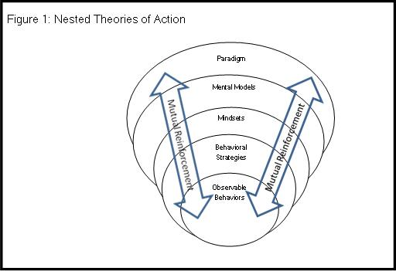
Many names for the representations we build and hold and apply
Maps are the outcome of learning from experience
  Gervase Bushe
The theory of action is a hypothesis – the broad approach to resolving the problem. The theory of action is not a course of action, but instead a simple and suggestive insight about how to solve the problem
  Argyris & Schon

Slide 61
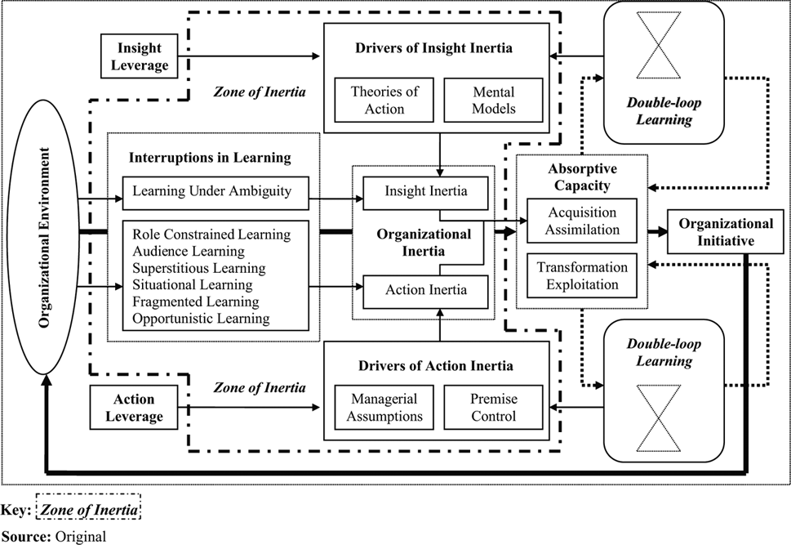
TOAs and MMs Cut Both Ways
http://www.emeraldinsight.com/journals.htm?articleid=1853414&show=html

Slide 62

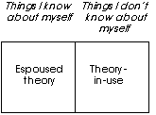
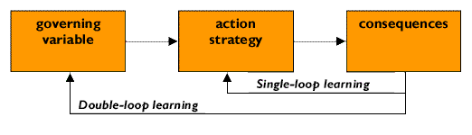
We may have multiple theories working
A model of the processes involved in Theory-in-Use
Notes:
Governing variables
The dimensions that people
are trying to keep within
acceptable limits. Any action
is likely to impact a number
of such variables. Thus any
situation can trigger a
trade-off among governing
variables.
Action strategy
The moves and plans used
by people to keep their
governing variables within
the acceptable range
Consequences
What happens as a result of
an action. These can be
both intended - those the
actor believe will result - and
unintended. In addition,
these consequences can be
for the self and/or others.

Slide 63
Single and double-loop learning
For Argyris and Schon (1978:2), learning involves the detection and correction of error.
Single-loop learning. Where something goes wrong, it is suggested, an initial port of call for many
people is to look for another strategy that will address and work within the governing variables. In
other words, given or chosen goals are operationalized rather than questioned. According to
Argyris and Schon (1974), this is single-loop learning. Single-loop learning seems to be present
when goals, values, frameworks, and to a certain extent, strategies are taken for granted. The
emphasis is on 'techniques and making techniques more efficient'. Any reflection is directed towards
making the strategy more effective. It involves following routines and some sort of preset plans -
and is both less risky for the individual and organization, and affords greater control.
Double-loop learning. An alternative response is to question the governing variables themselves,
to subject them to critical scrutiny. This they describe as double-loop learning. Such learning may
then lead to an alteration in the governing variables, and thus a shift in the way strategies and
consequences are framed. It involves the questioning the role of framing and learning systems
which underlie actual goals and strategies. This is more creative and reflective, and involves
consideration of the notions of the good. Reflection here is more fundamental: the basic
assumptions behind ideas or policies are confronted ... hypotheses are publicly tested ... processes
are dis-conformable not self-seeking. Thus, they came to explore the nature of organizational
learning.
The focus of much of Chris Argyris' intervention research has been to explore how organizations
may increase their capacity for double-loop learning. He argues that double-loop learning is
necessary if practitioners and organizations are to make informed decisions in rapidly changing and
often uncertain contexts (Argyris 1974; 1982; 1990). As Edmondson and Moingeon (1999: 160)
put it:
The underlying theory, supported by years of empirical research, is that the reasoning
processes employed by individuals in organizations inhibit the exchange of relevant
information (skilled unawareness and skilled incompetence) in ways that make double-loop
learning difficult -and all but impossible in situations in which much is at stake. This creates a
dilemma as these are the very organizational situations in which much is at stake. This creates
a dilemma as these are the very organizational situations in which double-loop learning is most
needed.
  http://www.lopn.net/TheoryofAction.html

