Slide 1
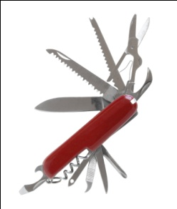
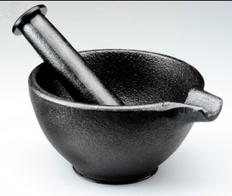
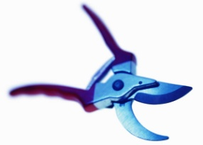
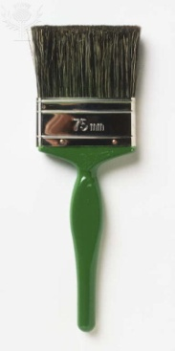
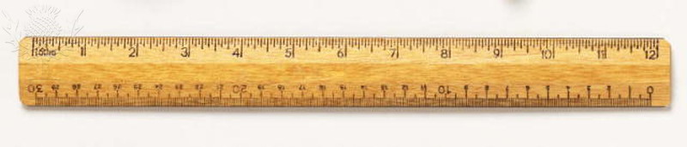
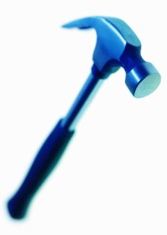

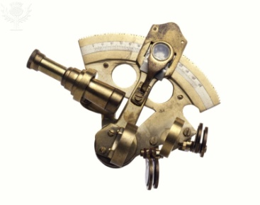
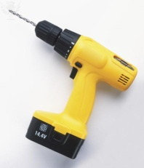

Ten Tools
A collection of organizational and individual methods to aid effectiveness

Slide 2
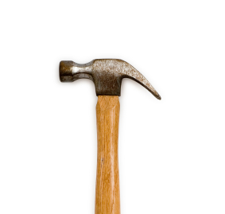
How do I add value?
How do I now what to do?
How do I know where to spend my time?
How do I know how to get things done?

Slide 3

Balancing Advocacy &
Inquiry
Ten Tools Session Five

Slide 4
How do I…
Know what to do?
  Gap analysis
  Sensemaking
  Ideal-setting
Get things done?
  Collaboration
  Performance
Nurture and enhance relationships?
  Collaboration
  Communication
Develop myself?
  Personal mastery
  Gap Analysis
  Sensemaking
Move people and their behavior from point A to point B?
  Gap analysis
  Influence
  Performance
Lead teams to produce desired results?
  Collaboration
  Performance
  Facilitation
Solve problems?
  Sense making
  Evaluation
  Performance
Notes:
The 10 tools are a set of ways of looking at the world in situations so as to be more effective. All of us at work are confronted with questions – if we bothered to be aware and we care about being successful – that need answers. And those answers must be more than mere prescriptions; those answers must contain within them the means by which we can make things different. The 10 tools are way for us to know more clearly what to do, to get things done more efficiently and more effectively with less breakdowns, to improve and strengthen our relationships that are critical to the success of any individual in any enterprise, to allow us to do capital C. change management, to lead teams to produce their objectives, and to solve problems.

Slide 5
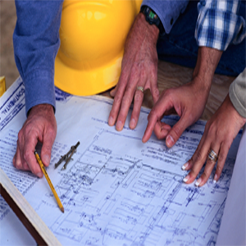
How do we produce results?
What is the sequence of activities that leads to a result?
What comes before action?

Slide 6

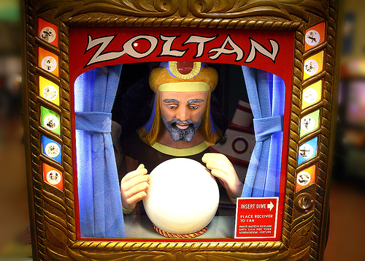
Decisions!
And what do we know about the best way to make decisions?

Slide 7
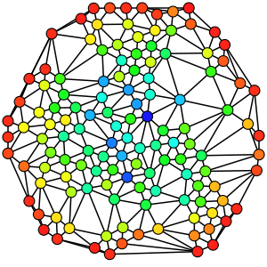
Reality Based Decision Making
Good decision making requires a grasp of the relevant reality
  observable facts and experience, things that are relevant and testable ⎯ even if the testing is only asking someone else if he or she is observing the same thing that you see
Just seek a good enough approximation

Slide 8

What’s ‘good enough’ reality?
The young specialist in English Lit…lectured me severely on the fact that in every century people have thought they understood the Universe at last, and in every century they were proved to be wrong. It follows, he said, that the one thing we can say about our modern “knowledge” is that it is wrong.
…My answer to him was…”When people thought the Earth was flat, they were wrong. When people thought the Earth was spherical, they were wrong. But if you think that thinking the Earth is spherical is just as wrong as thinking the Earth is flat, then your view is ‘wronger’ than both of them put together.”
  Asimov, I. (1996) The Relativity of Wrong, p. 226. New York: Kensington Books
Goal: Be Less Wrong

Slide 9

Testing Our Reality
Get to a “good enough” approximation of reality, test it, and then change it as needed.
But our values tend to influence our perceptions, and thus our decisions are not based purely on fact, or reality.
Many people fail to recognize that they select certain facts and brush aside others, guided by their “ought to be” model.
Many managers ⎯ senior and junior ⎯ don’t acknowledge the subjective element of “what ought to be” in their decisions.
Notes:
Reality Based Decision Making is about getting to a “good enough” approximation of reality, testing it, and then changing it as needed. But our values tend to influence our perceptions, and thus our decisions are not based purely on fact, or reality. As D.W. Taylor described the difference, “Questions of fact are questions of what is. Questions of value are questions of what ought to be.” Many people fail to recognize that they select certain facts and brush aside others, guided by their “ought to be” model. Many managers⎯senior and junior⎯don’t acknowledge the subjective element of “what ought to be” in their decisions.
Taylor, D.W. (1970) In R.M. Cyert & L.A. Welsch, Eds. Decision-making and Problem Solving in Management Decision-making, p. 33. Baltimore: Penguin Education

Slide 10

“Real knowledge is to know the extent of one’s ignorance.”
-- Confucius
How do you test your reality? How do you survey the border of your knowledge?
Other people can be a good source of additional information, useful knowledge, and valuable inquiry
Participatory decision making can lead to higher quality decisions

Slide 11
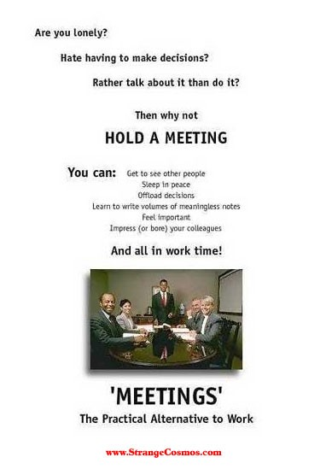
“Think about the meetings you’ve attended – those that were a hopeless waste of time and those that produced energy and great results. What was the difference? It was not the agenda, nor whether the meeting started on time or how disciplined it was, and certainly not the formal presentations. No, the difference was the quality of the dialogue.”
  Charan & Bossidy

Slide 12
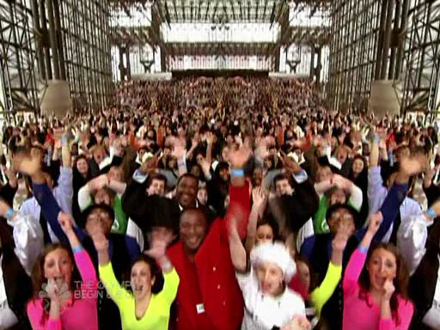
What gets in the way?
US!
Our Not Questioning Each Other
Argyris & Schon found in their research that few executives today operate in an environment where they can truly speak their mind, seek answers, and question a peer’s or superior’s reasoning
People made tacit agreements with each other not to question reasoning that appeared shaky or based purely on self-interest
Notes:
How many executives today operate in an environment where they can truly speak their mind, seek answers, and question a peer’s or superior’s reasoning? Chris Argyris and Donald Schon found in their research that the answer was “damn few.” People made tacit agreements with each other not to question reasoning that appeared shaky or based purely on self-interest. Argyris postulates that “cognitive impairment is the result of human striving for control,” that as “the incapacity to think develops, impairment results from faulty reasoning processes

Slide 13
From Ross & Roberts
“Large organisations tend to socialise leaders to be forceful, articulate advocates and problem solvers. We have been trained, generally by the modelling of others, about how to present and argue strongly for our views. “
“These underlying expectations are increasingly in conflict with the need for leaders to manage ambiguity and complexity, where there is no one answer and where the only viable option is for groups of informed and committed individuals to think together to arrive at new insights.”

Slide 14

Is making your point the point?
In business conversations, we often believe that our definition of what needs to be accomplished, and how it needs to be accomplished, is the only valid one.
  Fred Kofman
We seek to avoid any questioning of our reasoning. We focus exclusively on our POV being the one accepted

Slide 15
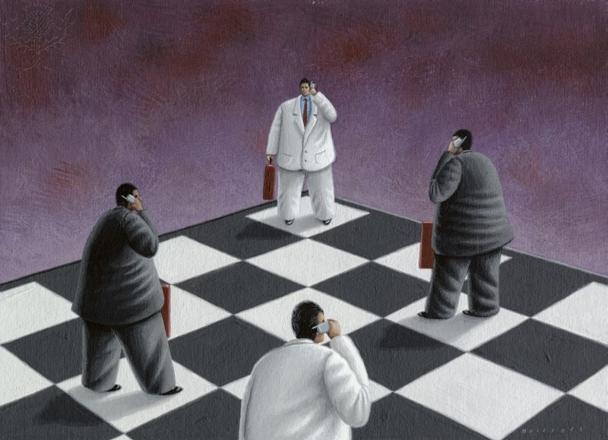
Are we stuck in a ‘not good enough’ reality?

Slide 16
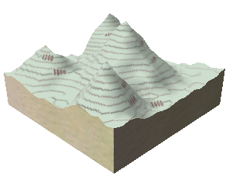
Our Cognitive Toolkits Create Local Optima
Individually, each of us applies our knowledge, perspectives and heuristics to arrive at the best solution we can…
…but that’s likely not the best solution overall.
1
2
4
3
utility of ideas
solutions landscape
* Scott Page, The Difference
4
Notes:
From Spigit slideshare deck by Hutch Carpenter

Slide 17

What helps?
Balancing Advocacy & Inquiry

Slide 18

What does it mean to balance advocacy & inquiry?
“When balancing advocacy and inquiry, we lay out our reasoning and thinking, and then encourage others to challenge us.
‘Here is my view and here is how I have arrived at it. How does it sound to you? What makes sense to you and what doesn't? Do you see any ways I can improve it?’ “

Slide 19
Balancing Advocacy & Inquiry
High
States conclusions
Imposes solutions
Gives no examples
Does not explain thinking
  Explains thinking
  Gives examples
  Seeks other’s view
  Probes thinking
  Encourages challenge
Advocacy
How people make statements
Observes
Withdraws
Asks general questions
  Seeks confirming views
  Asks leading questions
  Discourages challenge
Low
Low
High
Inquiry
How people ask questions

Slide 20

We don't recommend inquiry alone
“People almost always have a viewpoint to express, and it is important to express it -- in a context, which allows you to learn more about others' views while they learn more about yours.
Nor do we recommend that you switch in rote fashion from an adamant assertion ("Here's what I say") to a question ("Now what do you say?") and back again.
  Ross & Roberts

Slide 21

Balancing inquiry and advocacy means developing a variety of skills.
“It's as if all the "colors" of conversation could be spread out on an imaginary palette. As the creator of your part of the conversation, you should be able to incorporate styles from all four quadrants of the palette.”
  Ross & Roberts

Slide 22
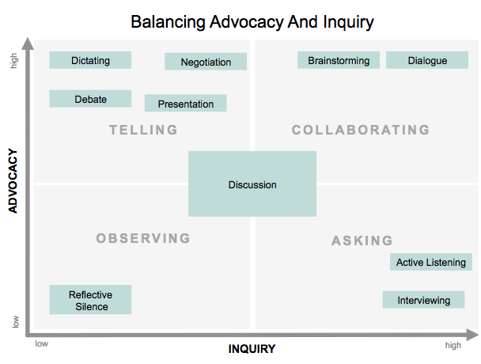

Slide 23
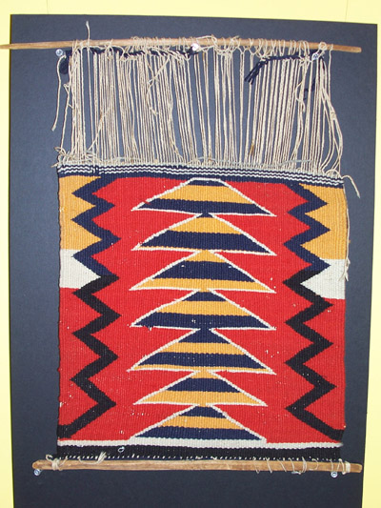
Weaving Multiple Perspectives Into a Powerful Image
“Balancing inquiry and advocacy is sometimes hard on people's cherished opinions, which is one reason why it is so difficult to master.
But the payoff comes in the more creative and insightful realizations that occur when people combine multiple perspectives. “

Slide 24
The Skills of Reflective Practice from Joe Raelin

Slide 25
Balancing Advocacy & Inquiry
High
States conclusions
Imposes solutions
Gives no examples
Does not explain thinking
  Explains thinking
  Gives examples
  Seeks other’s view
  Probes thinking
  Encourages challenge
Advocacy
How people make statements
Observes
Withdraws
Asks general questions
  Seeks confirming views
  Asks leading questions
  Discourages challenge
Low
Low
High
Inquiry
How people ask questions

Slide 26
Make your thinking process visible
(walk up the ladder of inference slowly)
What to do
What to say
State your assumptions, and describe the data that led to them.
"Here's what I think and here's how I got there."
Explain your assumptions.
"I assumed that. . ."
Make your reasoning explicit.
"I came to this conclusion because. . ."
Explain the context of your point of view: who will be affected by what you propose, how they will be affected, and why.
Give examples of what you propose, even if they're hypothetical or metaphorical.
"To get a clear picture of what I'm talking about, imagine the you're a customer who will be affected. . ."
As you speak, try to picture the other people's perspectives on what you are saying.
Protocols for Improved Advocacy

Slide 27
Publicly test your conclusions and assumptions.
What to do
What to say
Encourage others to explore your model, your assumptions, and your data.
"What do you think about what I just said?" or "Do you see any flaws in my reasoning?" or "What can you add?"
Refrain from defensiveness when your ideas are questioned. If you're advocating something worthwhile, then it will only get stronger by being tested.
Reveal where you are least clear in your thinking. Rather than making you vulnerable, it defuses the force of advocates who are opposed to you, and invites improvement.
"Here's one aspect which you might help me think through. . ."
Even when advocating, listen, stay open, and encourage others to provide different views.
"Do you see it differently?"
Protocols for Improved Advocacy

Slide 28
Ask others to make their thinking process visible.
Protocols for Improved Inquiry
What to do
What to say
Gently walk others down the ladder of inference and find out what data they are operating from.
"What leads you to conclude that?" "What data do you have for that?" "What causes you to say that?"
Use unaggressive language, particularly with people who are not familiar with these skills. Ask in a way that does not provoke defensiveness or "lead the witness."
Instead of "What do you mean?" or "What's your proof?" say, "Can you help me understand your thinking here?"
Draw out their reasoning. Find out as much as you can about why they are saying what they're saying.
"What is the significance of that?" "How does this relate to your other concerns?" "Where does your reasoning go next?"
Explain your reasons for inquiring, and how your inquiry relates to your own concerns, hopes, and needs.
"I'm asking you about your assumptions here because. . ."

Slide 29
Compare your assumptions to theirs
Protocols for Improved Inquiry
What to do
What to say
Test what they say by asking for broader contexts, or for examples.
"How would your proposal affect. . .?" "Is this similar to. . .?" "Can you describe a typical example. . .?"
Check your understanding of what they have said.
"Am I correct that you're saying. . .?"
Listen for the new understanding that may emerge. Don't concentrate on preparing to destroy the other person's argument or promote your own agenda.

Slide 30
Protocols for Facing a Point of View With Which You Disagree
What to do
What to say
Again, inquire about what has led the person to that view.
"How did you arrive at this view?" "Are you taking into account data that I have not considered?"
Make sure you truly understand the view.
"If I understand you correctly, you're saying that. . ."
Explore, listen, and offer your own views in an open way.
"Have you considered. . ."
Listen for the larger meaning that may come out of honest, open sharing of alternative mental models.
"When you say such-and-such, I worry that it means. . ."
Raise your concerns and state what is leading you to have them.
"I have a hard time seeing that, because of this reasoning. . ."

Slide 31
Protocols for When
You’re At An Impasse
What to do
What to say
Embrace the impasse, and tease apart the current thinking. (You may discover that focusing on "data" brings you all down the ladder of inference.)
"What do we know for a fact?"
"What do we sense is true, but have no data for yet?"
"What don't we know?"
Look for information which will help people move forward.
"What do we agree upon and what do we disagree on?"
Ask if there is any way you might together design an experiment or inquiry which could provide new information.
Listen to ideas as if for the first time.
Consider each person's mental model as a piece of a larger puzzle.
"Are we starting from two very different sets of assumptions here? Where do they come from?"
Ask what data or logic might change their views.
"What, then, would have to happen before you would consider the alternative?"
Ask for the group's help in redesigning the situation.
"It feels like we're getting into an impasse and I'm afraid we might walk away without any better understanding. Have you got any ideas that will help us clarify our thinking?"
Don't let the conversation stop with an "agreement to disagree."
"I don't understand the assumptions underlying our disagreement."
Avoid building your "case" when someone else is speaking from a different point of view.

Slide 32
  More Impasse Tactics from Fred Kofman
State the impasse or the dilemma explicitly, and ask for help: “I’m feeling stuck. On the one hand we need to create a flexible system, and on the other hand we need to cut all redundancies. I don’t know how to do both together. Do you have any ideas?”
If others appear closed to inquiring into their own views, ask what data or logic might change their views: “Can you think of any logical argument or piece of information that might disconfirm your view?”
Ask if there is any way to obtain new information: “Is there an experiment we might try that will provide us with more data?”
Invite them to reverse roles and see the world from a different standpoint: “If you were in my place, how would you proceed?”
Ask others to teach you how to express your view productively, i.e., in a way that does not create defensiveness in them: “How could I tell you about my concerns in a non‐aggressive manner? Can you help me state my perspective in a way that respects your views?”
If others are hesitant to express their views, encourage them to talk about the barriers: “What is it about this situation, me, or others that is making open exchange difficult?”

Slide 33
How do you know what the balance is between advocacy & inquiry

Slide 34
How Much Valid Information
Do You Seek?
Inspired by Kaner
divergence
convergence
The Groan Zone
non-obvious
obvious
decision point
start
decision point
What do
you lose?
What do
you gain?
Notes:
This relates both to role of facilitator and role of participant. They are both concerned with diamond.

Slide 35
Core Questions by Fred Kofman
Ask Yourself
Imagine the other’s response
What is my intention in this conversation?
Am I more interested in learning or in prevailing?
What are my beliefs and assumptions, and am I willing to change them?
What outcome matters most to me?
What is his/her intention in this conversation?
Is she/he more interested in learning or in prevailing?
What are his/her beliefs and assumptions, and is he/she willing to change them?
What outcome matters most to him/her ?
Learn the answers, and enter the exchange
with a stance of awareness, openness, curiosity and reflection,

Slide 36

How will you use this tool?
Where would I use this tool?
What would I expect to get out of it?
How would I use this tool?

