Slide 1
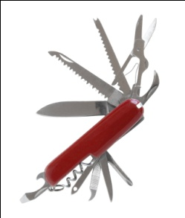
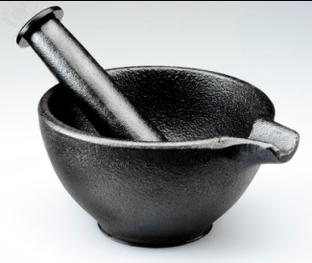



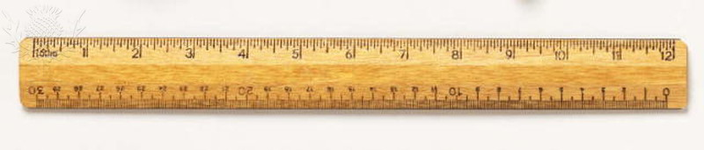



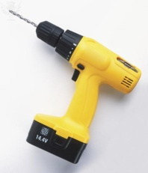
Ten Tools
A collection of organizational and individual methods to aid effectiveness

Slide 2
Session 1
Atom of Work

Slide 3
Ten Tools
Atom of Work
Gap Analysis
Difficult Conversations
Advocacy versus inquiry
Feed Forward & Johari Window
Team Effectiveness
Problem-solving techniques
Mental Maps
Seven Influence Strategies
Events of Instruction
Notes:
For those of you would looked at the materials from the last time that I offered the 10 tools series, you may notice a change in the sequence in which I am presenting the tools. I learned that there is one tool that is so fundamental it deserves primacy. And that is the Atom of Work. [Slide 2] All of the other tools that you see below will be ineffective — if not meaningless — unless there is use of the Atom of Work [Slide 4]

Slide 4
What Might You Gain From This Session?
Given a performance situation, you will
  be more effective in making requests to obtain what you need
  and/or
  be more effective in making promises to obtain what someone else needs
Notes:
[Pre-work is minimal and voluntary; participants are invited to check out some of the links. However, there is a beginning exercise that requires each participant to receive a different set of instructions for drawing a self-portrait. Someone needs to give these out as people enter and I need to allow two or three minutes for folks to complete the task. Not frm slides: As each participant enters the room, he or she is given a sheet of paper with a particular instruction regarding The self-portrait Exercise. They’re asked to look at the instructions and confirm that they will comply. There are sheets for requestors and performers. They are also asked not to share any information about what they are doing with other participants. Therefore, we will need a table set up for this particular session..]
Given a performance situation, you will
Know whether you are the Performer or the Requester with an understanding of the different obligations of each role to make certain effective collaboration and performance
Identify the differences between a request and an offer, a promise, an assessment , and an assertion
Identify different types of conversations especially a conversation for action and distinguish it from the other types
Identify the different segments of the Atom of Work
Diagnose when a breakdown has occurred in a conversation for action, and recommend remedies including making effective complaints that help both parties get back on track
Apply the Atom of Work methodology to positions in which you serve as Requester and situations in which you serve as performer

Slide 5
How do I…
Know what to do & get things done that add value?
  Atom of Work
  Gap Analysis
Nurture and enhance relationships?
  Atom of Work
  Advocacy versus inquiry
  Difficult conversations
Develop myself?
  Feed Forward & Johari Window
  Gap Analysis
Lead people and their behavior from point A to point B?
  Gap Analysis
  Seven Influence Strategies
  Events of Instruction
Help teams to produce desired results?
  Team Effectiveness
  Problem-solving techniques
  Mental Maps
Solve problems?
  Atom of Work
  Gap Analysis
  Problem-solving techniques
Notes:
The 10 tools are a set of ways of looking at the world in situations so as to be more effective. All of us at work are confronted with questions – if we bothered to be aware and we care about being successful – that need answers. And those answers must be more than mere prescriptions; those answers must contain within them the means by which we can make things different. The 10 tools are way for us to know more clearly what to do, to get things done more efficiently and more effectively with less breakdowns, to improve and strengthen our relationships that are critical to the success of any individual in any enterprise, to allow us to do capital C. change management, to lead teams to produce their objectives, and to solve problems.

Slide 6
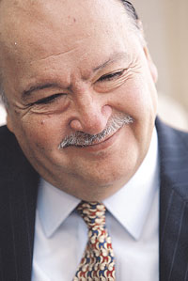
Our source for today is Fernando Flores
“Imprisoned for three years after the (1971) military led coup d’etat against the Allende government, he continued to reflect on the important question of how people work together to get things done, and began to formulate his ideas about communication and linguistic theory.”
Conversations for Action

Slide 7

The Atom Of Work Is A Means To Effective Collaboration At A Granular Level
Notes:
https://sharepoint.etslan.org/sws/sws/Leadership/Lists/Expanded%20Leadership%20Discussion%20%20new/Threaded.aspx?RootFolder=https%3a%2f%2fsharepoint%2eetslan%2eorg%2fsws%2fsws%2fLeadership%2fLists%2fExpanded%20Leadership%20Discussion%20%20new%2fBasic%20tools%20atom%20of%20work&FolderCTID=0x012002006E4779AC8CBCA1418B58A6E13AD32836
The Atom of work is a way of being disguised as a tool. Some tools shape the way we look at the world. The atom of work is such a tool.

Slide 8
Requester
Performer
Person asking for ‘something’ to be done
Person doing that ‘something’

Slide 9
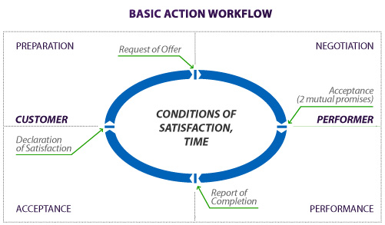
All value requires action, but not all action leads to value

Slide 10
45 Minutes of Fun
Context
Mindset
Preparation
Negotiation
Performance
Acceptance

Slide 11
  “Business is the exchange of entities to which values have been assigned”
Exchanges start with ASKING or OFFERING
They are the ‘atomic structure’ of all work
The Atom of Work exposes these exchanges at a more granular level both within and without the work organization as processes move to create value
Notes:
101 Things I Learned ® in Business School
https://books.google.com/books?isbn=0446569569
Michael W. Preis - 2010 - ‎Business & Economics
Business is the exchange of entities to which values have been assigned. 1 In business transactions, the values assigned to goods, services, or money may be ...

Slide 12

why bother learning about this tool?
What does it do?
Explicates the dynamics of how people BEST work together to get things done
Clarifies what comes next in such a transaction
Suggests ways around ‘breakdowns’

Slide 13

Mindset for Atom of Work
Using the Atom of Work requires different behaviors
Most Behavior starts with mindset; To act differently we have to view the world differently
Therefore, the assumptions that underlie the Atom of Work are critical

Slide 14
Community
Interdependence
Reciprocity
Agreement
Sharing
In Sync
Mutuality
COLLECTIVE
Getting things done
Understanding
Goodwill
In Common
Balance Exchange

Slide 15
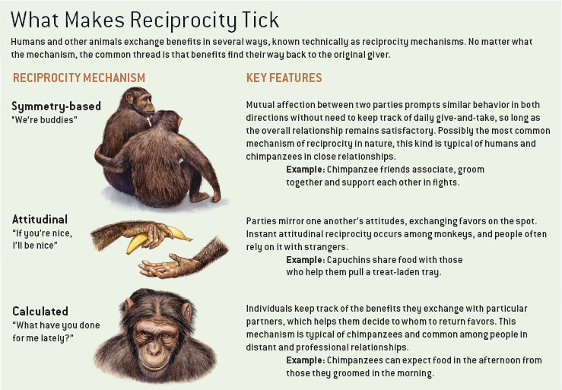
Deeply imprinted
Notes:
Frans De Waaal, Scientific American,
CREDIT: ROBERTO OSTI
How Animals Do Business
Frans B. M. de Waal
Scientific American 292, 72 - 79 (2005)
doi:10.1038/scientificamerican0405-72

Slide 16

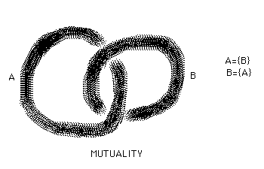
Real-World Effective Actions Require Mutuality
“All contracts, covenants, and agreements rest on mutuality, and the great advantage of the horizontal version of the social contract is that this mutuality binds each member to his fellow citizens.”
  Hannah Arendt
Notes:
Hannah Arendt, Crises of the Republic page 86 - 87

Slide 17

Real-World Effective Actions Require Mutuality
“A ‘world’ as I understand it consists of real people who are trying to get things done, largely by getting other people to do things that will assist them in their project. . . . The resulting collective activity is something that perhaps no one wanted, but is the best everyone could get out of this situation and therefore what they all, in effect, agreed to.”
  Howard Becker

Slide 18
Organizations require vast networks of atoms of work
people act by expressing assessments and promises
"Invent and manage a set of ongoing conversations for producing satisfaction for your customers" F. Flores
Notes:
people act by expressing assessments and promises

Slide 19
Context & Mindset Accepted:
Now What Do I Do?

Slide 20

“In order for action to occur between two people, one person must make a request or an offer to get things started. If no one makes a request, or no one makes an offer, nothing is going to happen between them!”
Fernando Flores
Request = Requester
Offer = Performer
Notes:
“In order for action to occur between two people, one person must make a request or an offer to get things started. If no one makes a request, or no one makes an offer, nothing is going to happen between them!
Once a request or an offer is made, then the ball (sic) is on the other person to determine what happens next, and so forth, until the person making the request, or accepting an offer, is satisfied. “
Fernando Flores

Slide 21
Splitting the atom
Promise of Agreement
(conditions of satisfaction)
Request or Offer
Requester
Performer
Declaration of Completion
Declaration of Satisfaction
Notes:
"… A person doesn't make a request simply to obtain a thing — that is, a concrete object or an event. People make request because they have concerns for the future in their dealings with others.… Accordingly, we see that in making requests and promises, we aren't specifying particular objects or events to be produced, but agreeing on conditions of satisfaction that will address the concerns we have in the world." I think there is an analog here to the negotiating principle held by experts like Stuart Diamond and Sheila Heen: focus on interests, not positions.

Slide 22
What are the key parts of the atom of work?
Request
Offer
Conditions of Satisfaction
Promise
Declaration of Completion
Declaration of Satisfaction
Start here

Slide 23
What is the first thing that you would do?
As requester?
As performer?
Clarify your concern: what is it that you wish to make happen? Move beyond "particular objects or events to be produced" and instead imagine the changed reality in which they exist. This shift will make it possible to better explain the conditions of your satisfaction
Conduct conversations: discuss with yourself and others what is needed in a performer who will fulfill your concerns. Get specific about a particular person who matches that profile.
Ask someone specific. Don't be ambiguous or ambivalent: part of requester responsibility is to be clear about whom, what, and why. What & why can and perhaps should be hashed out with the performer.
Make sure that you want to work with this person who appears to be making a request
If necessary, take 'two steps back‘, and have a preliminary conversation that establishes the right relationship going forward before even agreeing to enter into the possibility of being 'the performer‘
Ask questions and paraphrase answers: once the conversation turns to the possibility of your carrying out the action requested, make sure that you do everything you can to understand the conditions of satisfaction, the resources available, the interdependencies, and the time frame
Notes:
Clarify your concern: what is it that you wish to make happen? Move beyond "particular objects or events to be produced" and instead imagine the changed reality in which they exist. This shift will make it possible to better explain the conditions of your satisfaction, which constitute a very significant component of the Atom of Work
Conduct conversations: discuss with yourself and others what is needed in a performer who will fulfill your concerns. Get specific about a particular person who matches that profile.
Ask someone specific. Don't be ambiguous or ambivalent: part of requester responsibility is to be clear about whom, what, and why. The latter two — what & why — can and perhaps should be hashed out with the performer. A deliberate and explicit choice must be made as to the performer. Remember, "if everyone is responsible, then no one is responsible." Break down work into specific requests to individuals
Make sure that you want to work with this person who appears to be making a request
If necessary, take 'two steps back‘, and have a preliminary conversation that establishes the right relationship going forward before even agreeing to enter into the possibility of being 'the performer‘
Ask questions and paraphrase answers: once the conversation turns to the possibility of your carrying out the action requested, make sure that you do everything you can to understand the conditions of satisfaction, the resources available, the interdependencies, and the time frame

Slide 24

What are some ways in which you receive requests for work?
Make requests?

Slide 25

Are requests, promises, & offers always handled well in your work situation?
Notes:
Quick look at what was charted as practice supplemental
extra material

Slide 26
The Two Sides of Requests
A person makes a request when s/he would like someone to do something for him or her -- perform a service, deliver goods, prepare a report, etc.
Once you make a request to someone, you’re now in a role of a Requestor (Customer). It is up to you negotiate and agree on conditions of satisfaction with a performer, and declare whether or not these have been met satisfactorily by the performer.
When you accept a request, you are now in the role of Performer. It is up to you to negotiate as well, to revise conditions of satisfaction if necessary, and to report completion to the Customer.
Notes:
http://conversationsforaction.com/cfa-playground

Slide 27
Atom of Work
Promise of Agreement
(conditions of satisfaction)
Request or Offer
Speaking
Act &
Perform
Requester
Performer
Listening
Declaration of Completion
Declaration of Satisfaction
Notes:
From Ray Stata of Analog Devices:
In this model, most transactions between people in business boil down to requests and promises on the one hand, and offers and acceptances on the other. What is often missing from these transactions is a clear understanding of the conditions of satisfaction, including the requested response time. Also, there is often no explicit declaration of the completion of a promise or a check to see if the performance was satisfactory to the Requester.
A business process is a network of requests and promises linked across the company as performers become Requesters in requesting commitments and actions from other performers. … For recurring transactions, like bank loans, or order entry, formal systems are set up to standardize the requests and conditions of satisfaction. For system level or custom products, order entry is less standardized and reaching agreement on the condition of satisfaction is often the most significant part of a successful transaction.

Slide 28
Recall Those requests we discussed: did you think a commitment was made? end up with a result that left someone disappointed?
Was it because of our
speaking and listening?
Notes:
Reference slide 32 From Walden
Here is an example in which someone didn’t perform as well as I expected. Recently I asked a clerical person to edit a document for me by a certain date and time, and the person said he would. However, the person’s press of work was so great that he was unable to get to my work as promised. Therefore, I was unable for several days to do the next step in the process I was involved in.
Here is an example in which I didn’t perform as well as someone else expected. I recently was asked to produce a document by a certain date, and said I would. However, I had trouble figuring out how to do the project and didn’t get it done by the expected time. Therefore, it was unavailable to the person who needed it for a trip he had to make.
Here is an example where someone did more than I requested. I asked my secretary to ask the company library for any available information on a particular subject, hoping to get anything that was easy for the library to find. My secretary made the request of the library, and the library did an on-line search for which I eventually received a charge of many hundreds of dollars. Because I was not clear that my interest was only casual, I had to pay much more for the information than it was worth to me.
Finally, which of us hasn’t given someone advice only to have the person say “who asked you?” In other words, we sometimes respond to requests that haven’t been made, and people resent this.

Slide 29
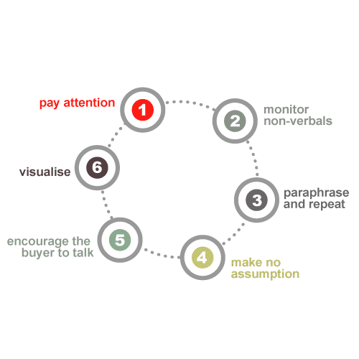
Listening is Critical
you
other

Slide 30
What Are You Really Hearing?
Requests? Promises? Offers?
Promises: linguistic statements we use to commit to future action
The believability of a promise, and thus the stock that should be placed in the commitment that is made, depends on the ‘promiser’s’ assessed
  Sincerity
    wants to keep the promise
  Competence
    has the skill to keep the promise
  and Reliability
    has a history of successfully accomplishing similar tasks or keeping similar promises
Requests: linguistic statements we use to elicit a specific promise from someone.
Offers: linguistic statements used to suggest that we are open to making a specific promise.
This is why relationship conversation comes 1st
Notes:
extra material

Slide 31
Offers and negotiations follow
Promise of Agreement
(conditions of satisfaction)
Request or Offer
Know who you are and where you are
Requester
Performer
31
Declaration of Completion
Declaration of Satisfaction

Slide 32
Requests Can Lead to Offers
Promise of Agreement
(conditions of satisfaction)
Request or Offer
What happens if a performer cannot say 'yes' to a request? He/she --after listening carefully and asking questions -- makes an offer
Requester
Performer
That offer may become through more negotiation, listening, and questioning the basis for the conditions of satisfaction,
which in turn are the frame of
'the promise'

Slide 33
The Promise Is Made:
What Comes Next?

Slide 34
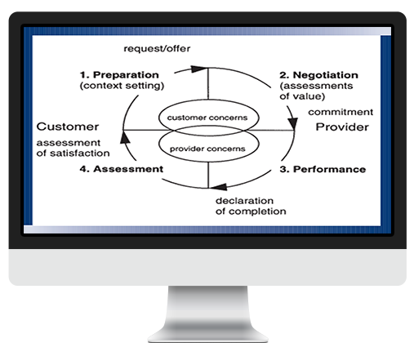
Performance
Completion
Satisfaction
Trust
Mutuality
Success
Value
Mission

Slide 35
What happens if it doesn’t work?
Request or Offer
Promise of Agreement
(conditions of satisfaction)
Where do you see people having the most problems effecting the atom?
Requester
Performer
Declaration of Completion
Declaration of Satisfaction

Slide 36
Atom of Work
Fernando Flores
Promise of Agreement
(conditions of satisfaction)
Request or Offer
What do you do when the performer declares completion but the requester is dissatisfied?
BREAKDOWN
Requester
Performer
Declaration of Completion
Declaration of Satisfaction
Notes:
From Ray Stata of Analog Devices:
… To address this, Flores talks about the importance of building trustful relationships with Requesters. At the center of any transaction between people are the underlying concerns of the Requester and performer which intersect in a domain of common interest. In a free society, a successful transaction occurs only when the concerns of both the Requester and the performer are addressed. An agreement between Requester and performer is based on a mutual exchange of value. That value is determined partly by the factual conditions of satisfaction, but also by an assessment by the Requester of the performer. Can I trust this person? What are the risks and consequences of failure?
Requester satisfaction depends not only on the performer meeting the agreed upon conditions, but also on whether or not the outcome addresses his or her concerns. Flores goes on to say we should look beyond just satisfying the conditions of a particular transaction to building trustful relationships with Requesters. Trust is built over time through performance. Also, trust is based on the Requester's assessment of your sincerity, competence, and involvement; that is, your commitment to a successful relationship. Requester relationships where trust is established are a very valuable, but hidden, asset of a company. [This trust is affected by our understanding of and facility in handling competing commitments and big assumptions.]
This concept of the Atom of Work sounds simple. However, the capability to reliably and consistently meet commitments across a company depends on linked networks of requests and promises. In most instances, these networks are never explicitly designed; they just evolve out of necessity. Therefore, the importance of negotiating clear, precise conditions of satisfaction based on a comprehensive understanding of the next step in the process, and meeting commitments at every step, is critical.

Slide 37
Have You Ever Suffered a Broken Promise?
What did you do?
Was it effective?
How did it happen? Use the Atom to pinpoint the sequence.
Share your tips and stories with your partners
Are you likely to blame the other person?
How does that turn out?

Slide 38
Breakdowns: problems as seeds of transformation
A breakdown is declared by either party in this atom of work cycle when they conclude that for some reason the promise can’t be kept
Once a breakdown is declared, there also needs to be a declaration of what actions need to be taken and someone has to take responsibility for correcting the breakdown
Breakdowns are opportunities to improve
Notes:
BUT… Correcting one breakdown may cause a breakdown in some other process

Slide 39

Effective Complaints
"Have they broken a promise or commitment to me?"
  In order to legitimately complain, a promise should exist.
Notes:
From Chris Chittenden The first thing to consider before complaining to someone is "Have they broken a promise or commitment to me?" In order to legitimately complain, we believe that a promise should have been made. We claim that it is not reasonable to complain about an outcome simply because our expectations were not met. A complaint should relate to an agreed outcome that has not been achieved. After all, if a promise has not been made, the other person may not even realise that we had any expectations in the first place.
In organisations, promises can be implied (and explicit) with the acceptance of a certain role within that organisation. For example, a position description will set out the responsibilities for a role and this will imply that certain promises are made by the person taking that position. Key Performance Indicators are the focus of many performance management systems today and are a more explicit way of making organisational promises.
If you believe a promise has been broken and a complaint is warranted, we recommend that you follow these steps.
Firstly, declare to the person that you have a complaint to make. This creates a context in which the person will understand that you are making a complaint. "I have a complaint to make to you"
Next, declare that the other person made a promise to you - "You promised to do ‘A’ in ‘X’ time." This provides the other person with the space to agree or deny that they had made any commitment to you. If they claim they had not made a commitment in the first place then this opens up a different conversation about the any misunderstanding that may have taken place. On reflection you may also find that you had not been clear in your request or actively listened for the request to be accepted. Remember, only when someone accepts your request do they make a promise to you.

Slide 40
Effective Complaints
"I have a complaint to make to you."
"You promised to create these conditions in this amount of time."
  Remember, only when someone accepts your request do they make a promise to you.
Notes:
From Chris Chittenden The first thing to consider before complaining to someone is "Have they broken a promise or commitment to me?" In order to legitimately complain, we believe that a promise should have been made. We claim that it is not reasonable to complain about an outcome simply because our expectations were not met. A complaint should relate to an agreed outcome that has not been achieved. After all, if a promise has not been made, the other person may not even realise that we had any expectations in the first place.
In organisations, promises can be implied (and explicit) with the acceptance of a certain role within that organisation. For example, a position description will set out the responsibilities for a role and this will imply that certain promises are made by the person taking that position. Key Performance Indicators are the focus of many performance management systems today and are a more explicit way of making organisational promises.
If you believe a promise has been broken and a complaint is warranted, we recommend that you follow these steps.
Firstly, declare to the person that you have a complaint to make. This creates a context in which the person will understand that you are making a complaint. "I have a complaint to make to you"
Next, declare that the other person made a promise to you - "You promised to do ‘A’ in ‘X’ time." This provides the other person with the space to agree or deny that they had made any commitment to you. If they claim they had not made a commitment in the first place then this opens up a different conversation about the any misunderstanding that may have taken place. On reflection you may also find that you had not been clear in your request or actively listened for the request to be accepted. Remember, only when someone accepts your request do they make a promise to you.

Slide 41
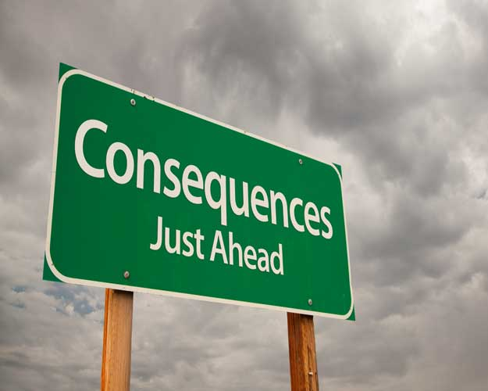
Effective Complaints
"You did not fulfill your promise“
"Your lack of fulfillment suggests to me that I can’t rely on you. As a result, the following has happened - consequence ‘X’, consequence ‘Y’, consequence ‘Z’ etc."
Notes:
If they do acknowledge they had made a promise to you, then you can proceed to the second stage which is to declare the promise has not been fulfilled - "You did not fulfill your promise". This is where it is critical to include a time frame when making a request. No time frame leaves you in a position where the other person can always legitimately say they had not got round to doing what you have requested yet. This declaration also allows the other person to indicate that they had done what had been asked if they had done so and you had not been aware of their actions. Again this provides the space for the other person to take care of their dignity in the conversation.
If they agree they did not meet their commitment then it is important to indicate the outcome of the broken promise. This step is often neglected but it sets up a critical context for the next step, which is making a new request. Potential outcomes from a broken promise include damage to the relationship, impacts on trust, financial loss, lost opportunity or concerns about identity. For example, "Your lack of fulfillment suggests to me that I can’t rely on you. As a result, the following has happened - consequence ‘A’, consequence ‘B’, consequence ‘C’ etc."
The final step of a complaint is for you to take some further action to address the breakdown caused by the broken promise. This takes the form of a new request that may well be more insistent than the initial request. For example, "I insist that you do the following - Action ‘A’, Action ‘B’ etc". Be sure to listen for acceptance of your request.

Slide 42
Effective Complaints
"I insist that you do the following - Action ‘A’, Action ‘B’ etc".
  Be sure to listen for acceptance of your request.
You may find in the course of making your complaint that your chain of reasoning is missing a few links, that the other person has come to a different conclusion about what was promised, the performance, etc.
Notes:
If they do acknowledge they had made a promise to you, then you can proceed to the second stage which is to declare the promise has not been fulfilled - "You did not fulfill your promise". This is where it is critical to include a time frame when making a request. No time frame leaves you in a position where the other person can always legitimately say they had not got round to doing what you have requested yet. This declaration also allows the other person to indicate that they had done what had been asked if they had done so and you had not been aware of their actions. Again this provides the space for the other person to take care of their dignity in the conversation.
If they agree they did not meet their commitment then it is important to indicate the outcome of the broken promise. This step is often neglected but it sets up a critical context for the next step, which is making a new request. Potential outcomes from a broken promise include damage to the relationship, impacts on trust, financial loss, lost opportunity or concerns about identity. For example, "Your lack of fulfillment suggests to me that I can’t rely on you. As a result, the following has happened - consequence ‘A’, consequence ‘B’, consequence ‘C’ etc."
The final step of a complaint is for you to take some further action to address the breakdown caused by the broken promise. This takes the form of a new request that may well be more insistent than the initial request. For example, "I insist that you do the following - Action ‘A’, Action ‘B’ etc". Be sure to listen for acceptance of your request.
keep the conversation going using the Team Effectiveness Model, which is one of our later segments in 10 Tools

Slide 43
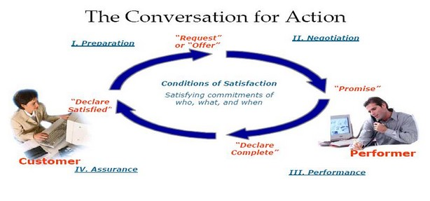

Slide 44

With whom will YOU use this tool?
Family & Friends
Customer
Manager
Vendor
Peer
Report
External Peers

Slide 45
Appendix
Atom of Work
Notes:
Use you tube clip http://www.youtube.com/watch?v=k9e3dTOJi0o

Slide 46

How do I add value?
How do I now what to do?
How do I know where to spend my time?
How do I know how to get things done?

Slide 47
Something is missing
Declaration
Of Need
Listening
Notes:
So now let’s take a closer work at the atom as the basis for a Conversation of Action

Slide 48
Something is Missing
Declaration
Of Need
Listening
Notes:
The idea that something is missing is an assessment of the Requester. He or she may be looking in the wrong place, fail to recognize what already is present. But it doesn’t matter because they think something is missing and you have to meet them at that point. However, you now recognize it as an assessment and not an assertion. So you don't go running off trying to immediately make a promise as to what you will do. That’s premature.

Slide 49
Something is Missing
Request
Declaration
Of Need
Listening
Notes:
Requests are the linguistic statements we use to elicit a specific promise from someone. So the request from the Requester is not gospel. It’s a starting point. It’s something that you can examine, clarify, question. It’s something against which you can make an offer.

Slide 50
How Do You Make Effective Requests?
Share Your Effective Request Tips
Tell What Makes Them Go Wrong All the Time
Use the ‘Atom’ to Pinpoint
Those Trouble Spots

Slide 51
Effective Requests
The atom of work begins when the Requester makes a request or the Performer makes an offer
Now the two parties have to really understand what will make the other satisfied with the transaction
The Requester should explain why he or she is making is this request:
  “I request so and so for the sake of …”
This allows the Requester to be very clear and the Performer better understand what is being requested
The Performer becomes a bigger part of the transaction through knowledge of what the request entails

Slide 52
Successful Requests,
Offers, and Promises
Several crucial elements determine a successful offer, promise, or request:
  sincerity;
  a community that shares similar concerns;
  a speaker and a listener;
  a presupposition of capability;
  the future action to be performed is specified;
  conditions of satisfaction including time are specified;
  and an unspoken historical background and context to create meaningfulness.

Slide 53
Something is Missing
Offer
Request
Declaration
Of Need
Listening
Notes:
Offers are the linguistic statements used to suggest that we are open to making a specific promise.
You could make an offer even where there was no request. You could se a need and make an offer. Offer is a place where you can negotiate, where you can redefine the situation as seen by the Requester, were you set the foundation for what will be your promise so it is important to introduce the things and time you want in order to address this need.

Slide 54
Invent Conditions of Satisfaction
Something is Missing
Offer
Request
Declaration
Of Need
Listening
Notes:
If your offer was well received then you can go to inventing conditions of satisfaction. They must come from the Requester, but you might well solicit and certify them. (So if I hear you correctly, your conditions of basification on this are …?)And they should be specific. I like to put them in writing. Give example of Bruce Gilbertson group. Give example of course outlines. This is where email is a godsend.

Slide 55
Invent Conditions of Satisfaction
Something is Missing
Offer
Request
Declaration
Of Need
Negotiations
Agreements
Listening
Notes:
Now you make it specific.

Slide 56
Invent Conditions of Satisfaction
Something is Missing
Offer
Competing
Commitments
Request
Declaration
Of Need
Negotiations
Agreements
Listening
Notes:
If you don’t view what is going on here as linked to your own way of looking at the world then you will get in trouble. Why? You must have a sense of your competing commitments that might make it difficult for you to stick to the agreements that you have. Additionally, you may find that your Requester has competing commitments that make it difficult to stick to the agreement. For example, he or she want to be seen as nice and therefore can’t abide by your agreement that they will make people asking for a service come through you. We will deal more with competing commitments in a little while, but I wanted flag them now.

Slide 57
Invent Conditions of Satisfaction
Something is Missing
Offer
Competing
Commitments
Request
Declaration
Of Need
Negotiations
Agreements
Listening
Promise
Notes:
Don’t make promises that you can’t keep. Promises are the linguistic statements that we use to commit to future action
The believability of a promise, and thus the stock that should be placed in the commitment that is made, depends on the ‘promiser's assessed
sincerity (wants to keep the promise)
competence (has the skill to keep the promise)
and reliability (has a history of successfully accomplishing similar tasks or keeping similar promises)

Slide 58
Invent Conditions of Satisfaction
Something is Missing
Offer
Competing
Commitments
Request
Declaration
Of Need
Negotiations
Agreements
Listening
Promise
Assessment
Performance

Slide 59
Invent Conditions of Satisfaction
Something is Missing
Offer
Competing
Commitments
Request
Declaration
Of Need
Negotiations
Agreements
Listening
Promise
Problem
Assessment
Problem
“PROBLEM: BLAME OR TRANSFORMATION?”

Slide 60
Invent Conditions of Satisfaction
Something is Missing
Offer
Competing
Commitments
Request
Declaration
Of Need
Negotiations
Agreements
Listening
Who is to blame?
Promise
Problem
Assessment
Problem
“PROBLEM AS SEARCH TO FIX BLAME”

Slide 61
Invent Conditions of Satisfaction
Something is Missing
Offer
Competing
Commitments
Request
Declaration
Of Need
Negotiations
Let’s look
at the ways we are talking
to one another
Agreements
Listening
Who is to blame?
Promise
Problem
Assessment
Problem
“PROBLEM AS SEEDS OF TRANSFORMATION”

Slide 62
Your self-portrait
Notes:
As each participant enters the room, he or she is given a sheet of paper with a particular instruction regarding her self-portrait. They’re asked to look at the instructions and confirm that they will comply. They are also asked not to share any information about what they are doing with other participants. (Therefore, we will need a table set up for this particular session. Our current count is 95 attendees.)

Slide 63
4 different requests
Draw a picture of yourself
Draw a picture of yourself making it a portrait of your face
Draw a picture of yourself making it a portrait of your face taking up the whole other side of this page
Draw a picture of yourself making it a portrait of your face taking up the whole other side of this page ⎯ take no more or less than sixty seconds to do so
Each appeared on a separate sheet of paper and prefaced with this text: “Your mission if you choose to attend this session.”

Slide 64
Your self-portrait: what happened?
Promise of Agreement
(conditions of satisfaction)
Request or Offer
Requester
Performer
Declaration of Completion
Declaration of Satisfaction

Slide 65
4 different requests: what’s the difference?
Draw a picture of yourself
  A simple request that fails to provide any detail
Draw a picture of yourself making it a portrait of your face
  Now one of the conditions of being able to fulfill the request is to draw a particular type of picture
Draw a picture of yourself making it a portrait of your face taking up the whole other side of this page
  Now another condition of satisfaction that makes request more specific
Draw a picture of yourself making it a portrait of your face taking up the whole other side of this page ⎯ take no more or less than sixty seconds to do so
  Finally, the request contains a requirement as to the amount of time allotted.
Which is what I wanted all along!

Slide 66

Misunderstood requests, promises, offers, conditions, and acceptances create a breakdown

Slide 67
Why did our breakdown occur?
Request or Offer
Promise of Agreement
(conditions of satisfaction)
Where Breakdowns Occur
Requester
Performer
Declaration of Completion
Declaration of Satisfaction
Notes:
I made a bad request
You did not feel you could negotiate
Neither of us was specific about conditions of satisfaction

Slide 68




have you ever had an ‘atom of work’ breakdown as requester or performer at work? how did you feel?
Was the request
the problem?
Notes:
So let’s talk about what the atom of work can do to prevent that

Slide 69
Notes:
Very different conversations
We can think about conversations for relationships, conversations for possible actions and conversations for coordinating action as being related,
Once we have decided that it’s a good idea to have a tentative relationship with the other person, we may try to discover if there might be some actions we might usefully take together. In other words, we might begin a conversation for possible actions.
If we discover an action that we might usefully take together, then we need to move on to a conversation for coordinating action
Notice that jumping straight to the conversation for coordinating action without having a conversation for possible actions or building a relationship can be counter-productive. We may not have sorted out enough about our relationship or individual concerns to be able to develop sufficiently matched expectations that would result in completed actions that both parties will be satisfied with.
From David Walden
Designing Effective and Efficient Action*
Draft by David Walden, 6/22/96 (slightly revised Spring ’97)
“We can think about conversations for relationships, conversations for possible actions and conversations for coordinating action as being related, as shown in the figure, where each oval and key word represents one of these three types of conversations.
We begin with conversations for relationships (the outside oval). When we meet each other for the first time, we usually start by beginning to build a tentative relationship. We introduce ourselves to each other, we say what a nice day it is, we mention something about some current event in the news that morning to see if we have any commonality of interest—“how about those Red Sox: they don’t usually begin their annual collapse so early in the season.” We are looking for early signs of what we may have in common. Basically, we are trying to determine if it’s safe (physically or emotionally) to be near the other person. Think about what happens when someone you have never met comes up to you on the street and begins a conversation: we are very chary as we figure out if this person wants something we are willing to give (such as directions to a nearby location) or if it’s better to try to get away from them before they try to take something we don’t want to give.
Once we have decided that it’s a good idea to have a tentative relationship with the other person, we may try to discover if there might be some actions we might usefully take together. In other words, we might begin a conversation for possible actions (the middle oval). This part of the model should feel very familiar to anyone in sales.
If we discover an action that we might usefully take together, then we need to move on to a conversation for coordinating action (the inner-most oval), which we’ll return to in a minute.
Notice that jumping straight to the conversation for coordinating action without having a conversation for possible actions or building a relationship can be counter-productive. We may not have sorted out enough about our relationship or individual concerns to be able to develop sufficiently matched expectations that would result in completed actions that both parties will be satisfied with.”

Slide 70
Trust
World-view
Did We
Jump
To
Action
Too
Soon?
Performance
What is performance like when trust is absent and world-views clash?
Notes:
From David Walden
Designing Effective and Efficient Action*
Draft by David Walden, 6/22/96 (slightly revised Spring ’97)
Notice that jumping straight to the conversation for coordinating action without having a conversation for possible actions or building a relationship can be counter-productive. We may not have sorted out enough about our relationship or individual concerns to be able to develop sufficiently matched expectations that would result in completed actions that both parties will be satisfied with.

Slide 71

Notes:
From David Walden CQM Designing Effective and Efficient Action*
Draft by David Walden, 6/22/96 (slightly revised Spring ’97)
“The first conversation we will mention is conversations for conversations, which are used to decide what type of conversation we should be having.
We have all had the experience of being in a situation with another person when we are having different conversations. For instance, if I am in development and you are in sales, you might come to me and ask me if some special option for the product was possible, and I might tell you that it is. Later, you might discover that I have not assigned anyone to work on this special feature. After an acrimonious discussion we might discover that, when we first talked, you thought we were having a conversation for action, and I thought we were having a conversation about possible actions. So, the first type of conversation we introduce is the conversation for conversations during which we decide what type of conversation we should be having. Taking the time to have a conversation for conversations can save a lot of trouble.
Before going on to talk about the other four conversations, I’d just like to mention that some types of conversations are often not very productive and are better avoided, for instance, conversations of judgments and stories about who did what to whom in the past are unproductive and best avoided.
“

Slide 72

Assertion or Assessment?
Why does that matter very much?
Will verification be a judgment call?
Will that make trouble?
Conditions of Satisfaction
declaration
DECLARATION

Slide 73
Assessments Are Not Assertions
Gary Burchill and David Walden
Failing to distinguish between assertions
    (observations for which supporting evidence is immediately evident)
and assessments
    (judgments for the purpose of selecting future actions that may or may not be well-grounded)
can lead to confusion
Where?
  The need? Is that the something that is missing?
    Example: training solves every problem
  The conditions?
  The completion?
Notes:
extra material

Slide 74
Assessments Are Not Assertions
Failing to distinguish between assertions
and assessments
can lead to confusion
2
+ 2
5
THIS IS WRONG.
THIS IS WRONG.
Notes:
extra material

Slide 75
Assessments Are Not Assertions: Watch Your Listening, Performers
Stating that the Requester doesn't understand what they need is typically an assessment (perhaps ungrounded), typically (perhaps not consciously) for the sake of ignoring Requester input as we go forward.
Treating this statement as a demonstrable assertion may have undesirable consequences.
It can cause one to miss the opportunity to discover what the Requester organization or individual thinks it needs and thus limit the opportunity to do business with the Requester.
Notes:
extra material
Gary Burchill and David Walden

Slide 76
Invent Conditions of Satisfaction
Something is Missing
Offer
Competing
Commitments
Request
Declaration
Of Need
Negotiations
Agreements
Listening
Verify results
Promise
One more time: what is most important in using the AOW as a guide?
Assessment

Slide 77
Invent Conditions of Satisfaction
Something is Missing
Offer
Competing
Commitments
Request
Declaration
Of Need
Negotiations
Declare
Satisfaction
Agreements
Listening
Verify Results
Promise
Problem
Assessment
Problem
“PROBLEMS AS SEEDS OF TRANSFORMATION”

Slide 78
Invent Conditions of Satisfaction
Something is missing
Offer
Competing
Commitments
Request
Speech Act
Completion
Propels You
To
Next Phase
Declaration
Of Need
Negotiations
Declare
Satisfaction
Agreements
Listening
Promise
Problem
Assessment
Problem
“PROBLEMS AS SEEDS OF TRANSFORMATION”

Slide 79
Your Situation
Given your accountabilities answer these questions and discuss why & how the Atom of Work might help you better accomplish them
What are the requests?
What are the offers?
What are the promises?
Where are breakdowns occurring?

Slide 80

A background Book co-authored by Flores

Slide 81
Appendix

Slide 82
Video Interlude
http://www.youtube.com/watch?v=Kgguebd5asQ

Slide 83
Invent Conditions of Satisfaction
Something is Missing
Offer
Competing
Commitments
Request
Declaration
Of Need
Negotiations
Let’s look
at the ways we are talking
to one another
Agreements
Listening
Who is to blame?
What is the root cause?
Promise
Problem
Assessment
Problem
“PROBLEM AS SEEDS OF TRANSFORMATION”

Slide 84
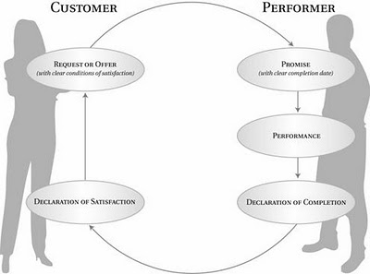
Notes:
http://blog.lithespeed.com/2007/09/commitment-based-management.html

Slide 85
Speech Acts:
A Prism for Looking at the Way We Talk
Language is action
Five basic speech acts exist:
  Assertions
  Declarations
  Assessments are a form of declaration
  Requests
  Offers
  Promises
They allow us to make sense of what we observe in our and others’ communication
Notes:
How many of you have heard of these? I won't bore you with the origins, but this very well-founded. It is also a major tool for companies as diverse as Analog Devices and General Electric, Citibank and Federal Reserve Bank, Bose and NASA.
It’s just a method, not magic or dogma. It’s just a useful way to understand the speaking and listening that goes on around us.

Slide 86
The Acts in Action
It’s Thursday
You screwed up!
Never again!
Give me another chance
I’ll work for free.
He’s crazy!
Can You Identify the Speech Acts?

Slide 87
Speech Acts:
Assertions
Statements that describe what already exists. What already exists may be facts of-the-world or of-the-word.
Because assertions are statements about what already exists, evidence should be available to support or disprove them.
“Today is Friday.”
Notes:
There’s extra material here, but I'll save it for anyone who has a question about the acts. Or you can read it on your own.

Slide 88
Speech Acts:
Assertions
Assertions may be either true or false. If one is making an honest assertion, one can be thought of as implicitly having evidence that one believes supports the assertion.
Assertions that turn out to be untrue will probably result in misplaced or ineffective action.
Assertions are a key tool of conversations for relationships, opportunities and breakdowns, and for finding shared concerns.
Notes:
extra material

Slide 89
What Are the Categories Into Which Our Speaking & Listening Fall?
We describe what is provable as true or false: assertions: “The sun is out.”
We make judgments about events that other might assess differently: assessments: “This is a good session.”
A declaration is an assessment in which someone with the authority to do so brings something into being that wasn't there before: “We are a team.”
We express our intentions to bring about certain conditions: promises. “I promise to be in my office tomorrow.”
We express our desire and hope that someone else act in a particular way: requests. “Please draw your face.”
We put forward the terms under which we would make a promise: offers. “If you can give me 2 weeks and an assistant, I would be willing to handle the inventory for you.”
Notes:
Do you know what I mean by these examples? When we speak either the reality can be clearly visible that we describe (assertion) or the reality that we describe is the one that has formed inside our head (declaration & assessment) One isn’t better than the other. We would not have gotten very far without being able to make assessments and then show how they are grounded. In fact that’s how science really works. But we need to know the difference.
When we are having what Flores called Conversations for action we are well served to know what’s a request, what’s an offer, what’s a promise, and what are the conditions of satisfaction. It helps if there is a breakdown rather tan just saying the other person is a creep to go back to the speech that did (or did not) occur and see what could happen better next time. You can’t go back to something unless you can clearly identify it. Hence the labels that you see on this slide.
The atom of work starts with a Requester or speaker who typically makes a request of a performer or listener.
"A declaration is an utterance in which someone with the authority to do so brings something into being that wasn't there before." President Kennedy declared that "America will put a man on the moon within this decade." Having the authority to make the declaration, he provided a context for action.
In your company, declarations provide leadership and guidance. If you live up to your declaration it instills trust and it communicates that you take the values and mission of the organization seriously.

Slide 90
Give Some Examples of Assertions
Notes:
Quick look at what was charted as practice supplemental
extra material

Slide 91
Speech Acts: Declarations
Declarations generate a new reality and are made in the context of some action.
They cannot be true or false as they seek to create something that does not exist. Hence the listeners can see declarations as either valid or invalid depending upon the power that they grant the speaker to generate the stated future action.
An example of a declaration is "Let us take a break." However, this would only be valid if the listeners accept the speaker's power to declare a break.
Notes:
extra material

Slide 92
Speech Acts: Assessments
Statements each of us makes where we individually evaluate the world (physical, emotional, etc.) that we see, and make judgments for the sake of future actions.
Assessments can either be grounded (follow the good-reasoning traditions the people of an organizational culture have) or ungrounded.
Notes:
extra material

Slide 93
Speech Acts: Assessments
For example, consider the statement, "We should not do business with company X because it is unreliable."
It would be grounded if facts could be provided to support the claim. It would be valid also if the speaker had the authority to determine the company's business partners.
.

Slide 94
Give Some Examples of Assessments You Hear in Your Work Situation
Notes:
Quick look at what was charted as practice supplemental
extra material

Slide 95
Promises are declarations: what does that mean?
They’ re not factual
What does that require of us?
More negotiation and checking of understanding
PROMISE
REQUEST
Conditions of Satisfaction
OFFER
declaration
DECLARATION

Slide 96
Requests That Failed to Satisfy
For instance, all of us have frequently made a request of someone else or had a request made of us, thought a commitment was made, and ended up with a result that left someone disappointed.
Here is an example in which someone didn’t perform as well as I expected. Recently I asked a clerical person to edit a document for me by a certain date and time, and the person said he would. However, the person’s press of work was so great that he was unable to get to my work as promised. Therefore, I was unable for several days to do the next step in the process I was involved in.
Here is an example in which I didn’t perform as well as someone else expected. I recently was asked to produce a document by a certain date, and said I would. However, I had trouble figuring out how to do the project and didn’t get it done by the expected time. Therefore, it was unavailable to the person who needed it for a trip he had to make.
Here is an example where someone did more than I requested. I asked my secretary to ask the company library for any available information on a particular subject, hoping to get anything that was easy for the library to find. My secretary made the request of the library, and the library did an on-line search for which I eventually received a charge of many hundreds of dollars. Because I was not clear that my interest was only casual, I had to pay much more for the information than it was worth to me.
Finally, which of us hasn’t given someone advice only to have the person say “who asked you?” In other words, we sometimes respond to requests that haven’t been made, and people resent this.
Notes:
Designing Effective and Efficient Action*
Draft by David Walden, 6/22/96 (slightly revised Spring ’97)

Slide 97
An Offer as Example
What I offer to do for participants:
Session Design & Facilitation - “Atom Of Work as part of Ten tools. You’ll learn about this stool
3 Conditions for my doing this:
1) People by email accept the design and the following conditions
2) Participants are willing to change practices
3) Participants are willing to question practices

Slide 98
Speech Acts:
Assertions Vs. Assessments
It is important to understand the difference between assertions and assessments, when we listen to others or speak them ourselves.
Many people speak assessments with the conviction of truth — as if they were assertions.
Problems proliferate when this occurs:
  How can trust exist when what someone says is true turns out only to have been their judgment of what should be?
  How can communication succeed when one of the persons fails to acknowledge that what he or she says is an assessment — just one view of the world?

Slide 99
How Speech Acts Alter Listening
Does the speaker believe what he is saying is an assertion or assessment?
If it is an assessment, does the speaker say it with the conviction of truth? How will this affect my attempts to communicate with him?
Do I recognize whether my responses to the speaker are assertions or assessments?
In other words, am I as convinced that what I have to say is truth? Do I ground my assessments?
Listening comes about when I am open
  Most commonly, a willingness to examine my own assumptions and beliefs
Notes:
I know that you might object that some of your clients will not like your observation that their assertions are really only judgments, and that their reasoning used to reach them might be flawed. However, you will have a better way of diagnosing the situation, and you can start to introduce the idea that it is valuable to call an assessment an assessment. Then when disagreement occurs you can each look at the reasoning process employed to reach such a conclusion.

Slide 100
eliciting or making promises? speaking with specificity creates a sense of accountability and commitment.
Use, and encourage your employees to use, phrases like:
Don't use, and don't let your staff use, phrases like:
Yes, I will.
I am not sure but I will give you a firm answer by noon tomorrow.
I will make the time to get this done.
I promise to close the loop by noon tomorrow so we can proceed.
By Friday, March 18 at 2:00 pm Central.
I will make it happen.
Do. Or do not. There is no try.
We'll see.
I'll try.
If I have the time for this.
I will get back to you on that.
Maybe.
When I get around to it.
Dude, chill. Like, it will get done when it is meant to get done.
Notes:
Source: ACCR Newsletter 03/15/2011

Slide 101
Perform: to carry into effect
What surrounds action and performance?
Act &
Perform
Notes:
From Ray Stata of Analog Devices:
In this model, most transactions between people in business boil down to requests and promises on the one hand, and offers and acceptances on the other. What is often missing from these transactions is a clear understanding of the conditions of satisfaction, including the requested response time. Also, there is often no explicit declaration of the completion of a promise or a check to see if the performance was satisfactory to the Requester.
A business process is a network of requests and promises linked across the company as performers become Requesters in requesting commitments and actions from other performers. … For recurring transactions, like bank loans, or order entry, formal systems are set up to standardize the requests and conditions of satisfaction. For system level or custom products, order entry is less standardized and reaching agreement on the condition of satisfaction is often the most significant part of a successful transaction.

Slide 102

first, you need to follow an effective sequence for action: relationship comes 1st
Relationship
Possibilities
Action
  Request
  Offer
  Conditions
  Promise
  Declaration of Completion
  Declaration of Satisfaction
Very different conversations

Slide 103
What kind of conversation were we having?
A conversation about conversations?
A conversation for relationships ?
A conversation for possibilities?
A conversation for possible action? For coordinating action?
A conversation for breakdowns?
Notes:
We can think about conversations for relationships, conversations for possible actions and conversations for coordinating action as being related, as shown in the figure, where each oval and key word represents one of these three types of conversations.
We begin with conversations for relationships (the outside oval). When we meet each other for the first time, we usually start by beginning to build a tentative relationship. We introduce ourselves to each other, we say what a nice day it is, we mention something about some current event in the news that morning to see if we have any commonality of interest—“how about those Red Sox: they don’t usually begin their annual collapse so early in the season.” We are looking for early signs of what we may have in common. Basically, we are trying to determine if it’s safe (physically or emotionally) to be near the other person. Think about what happens when someone you have never met comes up to you on the street and begins a conversation: we are very chary as we figure out if this person wants something we are willing to give (such as directions to a nearby location) or if it’s better to try to get away from them before they try to take something we don’t want to give.
Once we have decided that it’s a good idea to have a tentative relationship with the other person, we may try to discover if there might be some actions we might usefully take together. In other words, we might begin a conversation for possible actions (the middle oval). This part of the model should feel very familiar to anyone in sales.
If we discover an action that we might usefully take together, then we need to move on to a conversation for coordinating action (the inner-most oval), which we’ll return to in a minute.
Notice that jumping straight to the conversation for coordinating action without having a conversation for possible actions or building a relationship can be counter-productive. We may not have sorted out enough about our relationship or individual concerns to be able to develop sufficiently matched expectations that would result in completed actions that both parties will be satisfied with.

Slide 104
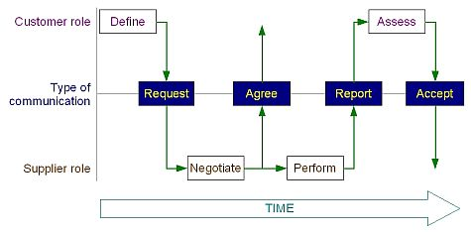
Another way of looking at Conversations for Action
Here we see the sequence along a timeline

Slide 105

why is the atom of work important?
Because the creation of value in most circumstances requires coordinated actions
Value added (narrowly) = [sale price or mission impact of product] - [cost of materials and labor to produce a product]
That difference occurs through individuals applying their skills, efforts, and knowledge to transform the organization's other resources
Organizations through their architecture (or network of relationships), innovation, and reputation add value
The coordination of efforts and the maintenance of relationships require an ‘atom of work’ , a model to understand the dynamics of successful production
“The only function of a business (including non-profits) is to create customer value”
Peter Drucker
Notes:
Is a value creating machine, whether for profit or not for profit
The only difference is that in the latter there must be consideration of qualitative outputs associated with mission as well as the generation of surplus
From a financial perspective, value is said to be created when a business earns revenue (or a return on capital) that exceeds expenses (or the cost of capital). But some analysts insist on a broader definition of "value creation" that can be considered separate from traditional financial measures. "Traditional methods of assessing organizational performance are no longer adequate in today's economy," according to ValueBasedManagement.net. "Stock price is less and less determined by earnings or asset base. Value creation in today's companies is increasingly represented in the intangible drivers like innovation, people, ideas, and brand."

Slide 106

Context
How are you part of adding value?
Do you have to ask other people to do things, to produce pieces of work?
Are you asked to perform certain functions, to produce specific results?
Are the effects in either or both cases part of what makes the difference between what it costs to offer something to the public and the price or impact of that 'something'?
Of course, you are part of value creation at ETS. And whether you are asking others, being asked, or both, you are involved in territory of the 'Atom of Work', of conversations for action.

Slide 107

We Expect Mutuality, we depend upon reciprocity, we honor duty
What would relationships resemble absent these expectations, these dependences, the honoring of these qualities?
Notes:
All contracts, covenants, and agreements rest on mutuality, and the great advantage of the horizontal version of the social contract is that this mutuality binds each member to his fellow citizens.
Crises of the Republic page 86 - 87

Slide 108
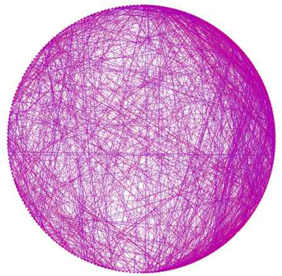
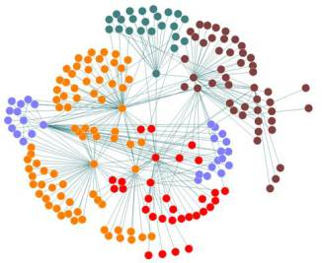
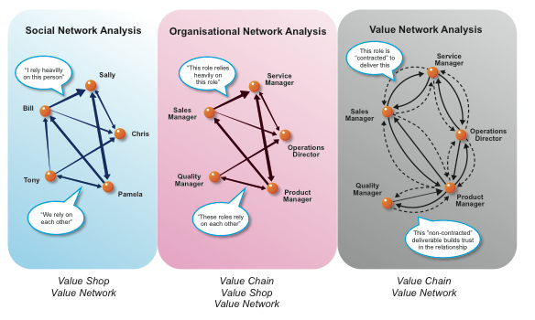
networks of commitments

Slide 109


Context & Mindset
Why do such conversations and interactions matter?
Because of the business side of our enterprise:
  “Business is the exchange of entities to which values have been assigned”
  Action in performance creates the entities in such a way as to also create the value
We make something where previously it did not exist.
Notes:
Quote by Michael W. Preis
from 101 things that I learned in business school
Because of the business side of our enterprise:
“Business is the exchange of entities to which values have been assigned”
Action in performance creates the entities in such a way as to also create the value
We see something that we want to create ⎯ a product, a system, a cultural shift ⎯ and working with others we plan and take the actions necessary to bring that new entity into being.
We make something where previously it did not exist.
To close the gap, between how we want it to be and how it is right now, we will design and deliver: take action. The way in which the entity is created involves a mixture of assets, performance, and relationships. Invariably, this mixture cannot be the work of one person. We must collaborate.
Collaboration requires conversations for action. A tool that can make these conversations more effective and deal with instances where they break down is the Atom of Work

Slide 110


Why do such conversations and interactions matter?
We make something where previously it did not exist.
How do we do that?
Through requests and offers that create the entity out a mixture of assets (including people’s knowledge and skills) , performance, and relationships.
Invariably, this mixture cannot be the work of one person. We must collaborate.
Effective collaboration requires conversations for action: requests, offers, promises and conditions.
Notes:
I repeated that bullet purposefully: that’s the foundation of work. Then we have to make sure it has value, but first even if we are doing the 100th or 1 millionth version of something it did not exist before we did it. That takes action, which leads to performance which leads to results.

Slide 111
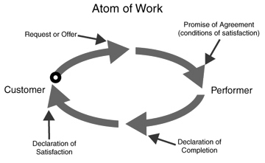

A tool that can make these conversations more effective and deal with instances where they break down is the Atom of Work

Slide 112
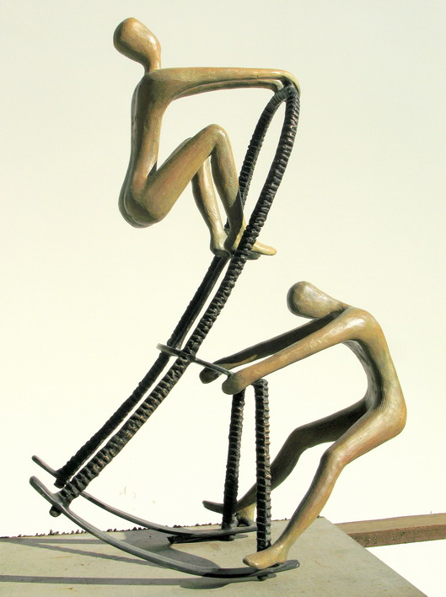
Two Roles: Requester & Performer
Choose One!
Speaker or Hearer
Requester or Performer
Client or Provider
Customer or Supplier
These are several different ways people describe the two roles of the 'Atom'. ('Customer' upsets some folks; not me!)
The labels don't matter, but choosing a role does: Understand the distinctions between the two roles and recognize that you can only play one role at a time.
Notes:
A photo of a sculpture from Tolla entitled "Give-and-Take"

Slide 113
Flores’ Advice For Requesters
Preparation
  Identify a Performer — With whom you have a relationship that suggests this will work
  Concern: What are you trying to take care of by making the request?
  Conditions of Satisfaction
  Time: “by when” ? SPECIFICALLY
  Mood
  Competence: Is this the right person to receive your request?
Negotiation
  Keep in mind that in a negotiation, the person you would like to fulfill your request may accept, but s/he may also counter-offer or decline, which will lead you to make other conversational moves in response.
Performance
  In this phase, lots of conversations can take place as the performer & requester (you) engage with one another to ensure that satisfaction.
Acceptance
  This is the phase that indicates that the performer has completed the work.
Notes:
http://conversationsforaction.com/cfa-playground
Identify a Performer: To whom are you making the request? Make sure you are directing your request to someone. It is common that people make requests to the “air”, hoping that someone will catch the request.
Concern: What is your concern in making the request? I.e. what are you trying to take care of by making the request?
Conditions of Satisfaction: What are your priorities, what will it take, for you to be satisfied that the request is fulfilled (quality, service levels, budgets, etc.)
Time: Make sure you specify “by when” you would like something. Your “soon” may be tomorrow, but the person listening to your request may interpret “soon” as a week or two from now or as "soon as they can get to it.“
Mood: What is your mood about making this request? If you are uncomfortable making the request or do not think that it will lead to anything valuable for you, is there some other action that may want to take first?
Competence: What is your assessment of the competence of the performer for fullfiling your request? Is this the right person to receive your request?
Negotiation Here person enters negotiation with person they would like to fulfill his/her request. Easy enough, but keep in mind that in a negotiation, the person you would like to fulfill your request may accept, but s/he may also counter-offer or decline, which will lead you to make other conversational moves in response. Performer can minimally agree, decline, or counter-offer. Customer can revise, and cancel the request.
Performance Congratulations you’ve entered Performance Phase. This is the phase where Performer works to deliver on his/her promise to you. In this phase, however, lots of conversations can take place as the two of you engage with one another to ensure that you are satisfied. Click continue and then Customer or Performer to see what moves are possible in this phase!
Acceptance This is the phase that indicates that the performer has completed the work.

Slide 114
Requests Can Lead to Offers
Promise of Agreement
(conditions of satisfaction)
Request or Offer
"… We say that in making requests, offers, and promises we don't specify particular objects or events to be produced, but rather agree on conditions of satisfaction that will address the concerns we have" Fernando Flores
What do you think that means?
Why is Flores drawing that distinction?
Requester
Performer

Slide 115
The Promise Is Made:
What Comes Next?
Promise
(Offer?)

Slide 116
Why did our breakdown occur?
Request or Offer
Promise of Agreement
(conditions of satisfaction)
Where Breakdowns Occur
Requester
Performer
Declaration of Completion
Declaration of Satisfaction

